Slide 1
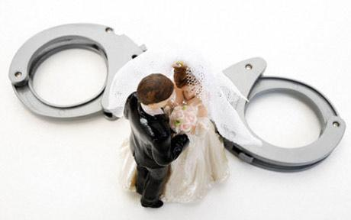
What are arranged marriages?
Why did they and do they happen?
Do they work? How does love fit in?

Slide 2
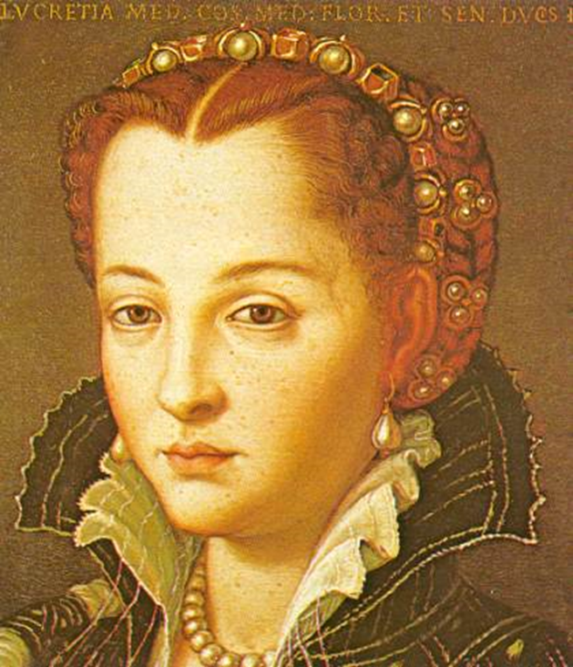
LO: To understand and be able to explore the poem ‘My Last Duchess’

Slide 3
Characters in the poem
The Duke
The envoy
The ex-wife
The Count
The Count’s daughter
Fra Pandolf

Slide 4
My Last Duchess
Robert Browning (1845)

Slide 5
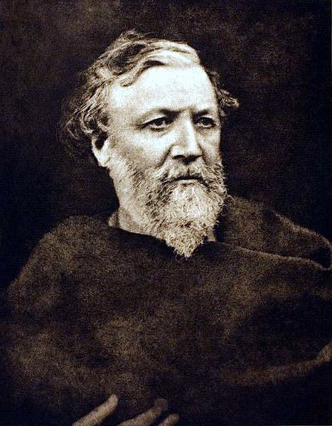
Robert Browning
Robert Browning was born in 1812 and was married to the poet Elizabeth Barrett in 1846. He died in 1889.

Slide 6
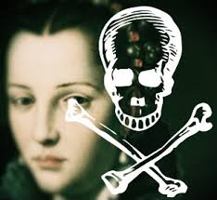
My Last Duchess
In this poem, Browning creates a character of chilling coldness and cruelty. The speaker is a Duke who is conducting negotiations for a bride, a new duchess. He is talking with the representatives of a Count, a potential father in law. Almost casually, he shows them the picture of the ‘last’ duchess whom (we assume...) he had killed because he could not dominate her.

Slide 7
My Last Duchess
That's my last duchess painted on the wall, Looking as if she were alive. I call That piece a wonder, now: Frà Pandolf's hands Worked busily a day, and there she stands. Will't please you sit and look at her? I said "Frà Pandolf" by design, for never read Strangers like you that pictured countenance, The depth and passion of its earnest glance, But to myself they turned (since none puts by The curtain I have drawn for you, but I) And seemed as they would ask me, if they durst, How such a glance came there; so, not the first Are you to turn and ask thus. Sir, 'twas not Her husband's presence only, called that spot

Slide 8
My Last Duchess
Of joy into the Duchess' cheek: perhaps Frà Pandolf chanced to say "Her mantle laps "Over my lady's wrist too much," or "Paint "Must never hope to reproduce the faint "Half-flush that dies along her throat": such stuff Was courtesy, she thought, and cause enough For calling up that spot of joy. She had A heart how shall I say? too soon made glad, Too easily impressed; she liked whate'er She looked on, and her looks went everywhere. Sir, 'twas all one! My favour at her breast, The dropping of the daylight in the West, The bough of cherries some officious fool Broke in the orchard for her, the white mule

Slide 9
My Last Duchess
She rode with round the terrace - all and each Would draw from her alike the approving speech, Or blush, at least. She thanked men good! but thanked Somehow I know not how as if she ranked My gift of a nine-hundred-years-old name With anybody's gift. Who'd stoop to blame This sort of trifling? Even had you skill In speech which I have not to make your will Quite clear to such an one, and say, "Just this "Or that in you disgusts me; here you miss, "Or there exceed the mark" and if she let Herself be lessoned so, nor plainly set Her wits to yours, forsooth, and make excuse, E'en then would be some stooping; and I choose Never to stoop. Oh sir, she smiled, no doubt, Whene'er I passed her; but who passed without

Slide 10
My Last Duchess
Much the same smile? This grew; I gave commands; Then all smiles stopped together. There she stands As if alive. Will't please you rise? We'll meet The company below, then. I repeat, The Count your master's known munificence Is ample warrant that no just pretense Of mine for dowry will be disallowed; Though his fair daughter's self, as I avowed At starting, is my object. Nay we'll go Together down, sir. Notice Neptune, though, Taming a sea-horse, thought a rarity, Which Claus of Innsbruck cast in bronze for me!
Read the poem and discuss it with a partner.
What do you think it is about?

Slide 11
Imagine the scene…
A stately home
A rich, devastatingly handsome Duke, flowing dark hair, bright blue eyes, a velvet jacket, an ornately embroidered waistcoat with gold buttons, a walking cane adorned with jewels.
An envoy – a man sent to meet the Duke – a lesser man, smartly dressed but does not have the Duke’s money or charisma and the Duke knows it.
The Duke takes the envoy around his home to show off his art collection, including a portrait of his late wife, the Last Duchess.

Slide 12
Questions
Who is the Duke of Ferrara talking to in the poem?
Why is his guest visiting the Duke of Ferrara?
Who painted the picture of the Duke’s late wife?
The Duke was not entirely pleased with his late wife, the Last Duchess. Explain why and what he did about it.
What impression of the Last Duchess do you get from the poem? Write about her as you imagine she might have been.

Slide 13
MILTS
Meaning
Imagery
Language
Tone
Structure
In groups, you are going to be given one of these headings to become experts on.
You will then choose a representative to move around and disseminate your knowledge to the rest of the class.

Slide 14
What is it about?
Based on the life of Alfonso II, Duke of Ferreira, Italy
The Duke’s first wife died in 1561 after 3 years of marriage
We learn about the Duke by what he says about her and how he says it
We also learn about their relationship; what was expected; how she responded
http://www.youtube.com/watch?v=DZxq3r7TlHo

Slide 15
The Duke is very possessive
Dramatic monologue
My Last Duchess
That's my last Duchess painted on the wall, Looking as if she were alive. I call That piece a wonder, now: Fra Pandolf's hands Worked busily a day, and there she stands. Will 't please you to sit and look at her? I said "Fra Pandolf" by design, for never read Strangers like you that pictured countenance, The depth and passion of its earnest glance, But to my self they turned (since none puts by The curtain I have drawn for you, but I) And seemed as they would ask me, if they durst, How such a glance came there; so, not the first Are you to turn and ask thus. Sir, 't was not Her husband's presence only, called that spot Of joy into the Duchess' cheek: perhaps
An imaginary artist, name dropping: everything has monetary value
He likes beautiful things
There is a reason for drawing the curtain, it’s so the person can see his prized possession

Slide 16
Fra Pandolf chanced to say, "Her mantle laps Over my lady's wrist too much," or "Paint Must never hope to reproduce the faint Half-flush that dies along her throat:" such stuff Was courtesy, she thought, and cause enough For calling up that spot of joy. She had A heart--how shall I say?--too soon made glad, Too easily impressed: she liked whate'er She looked on, and her looks went everywhere. Sir, 't was all one! My favor at her breast, The bough of cherries some officious fool Broke in the orchard for her, the white mule She rode with round the terrace--all and each Would draw from her alike the approving speech, Or blush, at least. She thanked men,--good! but thanked Somehow,--I know not how--as if she ranked My gift of a nine-hundred-years-old name
She was a modest person who got embarrassed by compliments
Her only crime was enjoying life and not respecting his rank/title
The Duke’s jealousy; he starts to reveal more than he planned
His only pride is in his wealthy family name
Contrast: genuine romance or a posh title, he expects her to value the latter more

Slide 17
With anybody's gift. Who'd stoop to blame This sort of trifling? Even had you skill In speech--(which I have not)--to make your will Quite clear to such an one, and say, "Just this Or that in you disgusts me; here you miss, Or there exceed the mark"--and if she let Herself be lessoned so, nor plainly set Her wits to yours, forsooth, and made excuse, --E'en then would be some stooping; and I choose Never to stoop. Oh sir, she smiled, no doubt, Whene'er I passed her; but who passed without Much the same smile? This grew; I gave commands; Then all smiles stopped together. There she stands As if alive. Will 't please you rise? We'll meet The company below, then. I repeat,
He accidentally reveals more of his weaknesses
What kind of man expects his wife to be rude like this?
He is getting jealous over her being kind
HE KILLED HER?
Makes monologue feel like conversation

Slide 18
The Count your master's known munificence Is ample warrant that no just pretence Of mine for dowry will be disallowed; Though his fair daughter's self, as I avowed At starting, is my object. Nay, we'll go Together down, sir. Notice Neptune, though, Taming a sea-horse, thought a rarity, Which Claus of Innsbruck cast in bronze for me!
Robert Browning (1812-1889)
He is talking to an emissary of his future wife’s father
Money for marrying his daughter
And a beautiful wife to boot
He returns to material things; all his money and power will never buy him love though
The Duke doesn’t realise how much of himself he has given away in his criticism of his former wife
young woman's "faults" were qualities like compassion, modesty, humility, delight in simple pleasures, and courtesy to those who served her.

Slide 19
Did you know?
The poem is written in iambic pentameter. This means that there are five feet in each line. Each foot contains two syllables. -
Traditionally, iambic pentameter is written in the following pattern of unstressed and stressed syllables.
Iambic pentameter often follows the natural rhythm of speech, a little like a heartbeat. If we apply this to pattern to Browning’s opening line, it would be as follows.
That’s my last duchess painted on the wall
Try reading it aloud a few times, sticking closely to the pattern of unstressed and stressed syllables as marked above.
Does the above rhythm sound natural? Does it seem to capture the meaning of the words in the line?
da | dum | da | dum | da | dum | da | dum | da | dum

Slide 20
The Duchess
There are a number of word sets and / or phrases within the poem. Work in small groups to collate evidence linked to the following areas:
The Duchess’ beauty: There is considerable evidence within the poem to suggest that the Duchess was beautiful, and that the Duke loved and admired her for this. Look for descriptions of her physical appearance. Identify the one aspect of her physical appearance that causes him annoyance?
The Duchess - alive or dead: The poem is extremely ambiguous about the Duchess’ fate. Is she alive or dead? Consider the tense of verbs at certain points in the poem. Did the Duke have her murdered?
The Duchess as art: Calder and Goodman have stated: “ … the Duchess’s translation into valuable ‘art’ confirms her status as a possessed ‘object’.” This will also link to:
Looking: There are many references to, or words associated with, looking.
Uncertainty: The Duke reveals uncertainty - with regard to himself and his wife - on a number of occasions within the monologue.

Slide 21
Fra Pandolf
 The artist who painted the fresco of the Duchess was called Fra Pandolf. The Duke seems particularly jealous and angered by the possible relationship that developed between the artist and the Duchess. What is the Duke’s attitude to Fra Pandolf? Look at:
lines 3 – 4;
lines 5 – 7;
lines 15 – 21.
“ … This grew; I gave commands; / Then all smiles stopped together.”

Slide 22
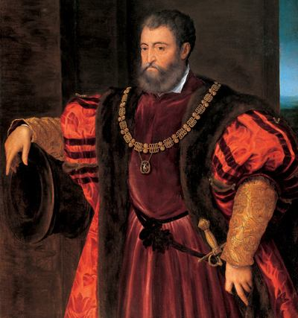
The Duke
Find an highlight anything in the poem that hints at the character of the Duke.
What is he like?
(hint) look for implicit meaning

Slide 23
Do you think… Read the statements below, decide which one you agree with most – why? Explain in detail
The Duke was jealous and angry about his wife’s relationship with the artist, Fra Pandolf, and therefore, he had her murdered.
The Duke was jealous and angry about his wife’s relationship with the artist, Fra Pandolf, and therefore, he had them both murdered.
The Duke loved his wife dearly.
The Duke loathed his wife and resents even the memory of her.
The Duke misses his wife.
The Duke views his wife as an object, a piece of art, something he owns.
The Duchess died and the Duke is still in mourning.
The Duke is furious because the Duchess left him and ran away with the artist, Fra Pandolf.
The Duke loves his wife but loathes the artist, Fra Pandolf.

Slide 24
LO: To understand and be able to explore the poem ‘My Last Duchess’
Write a summary of what you know now that you didn’t at the start of the lesson.

