Slide 1
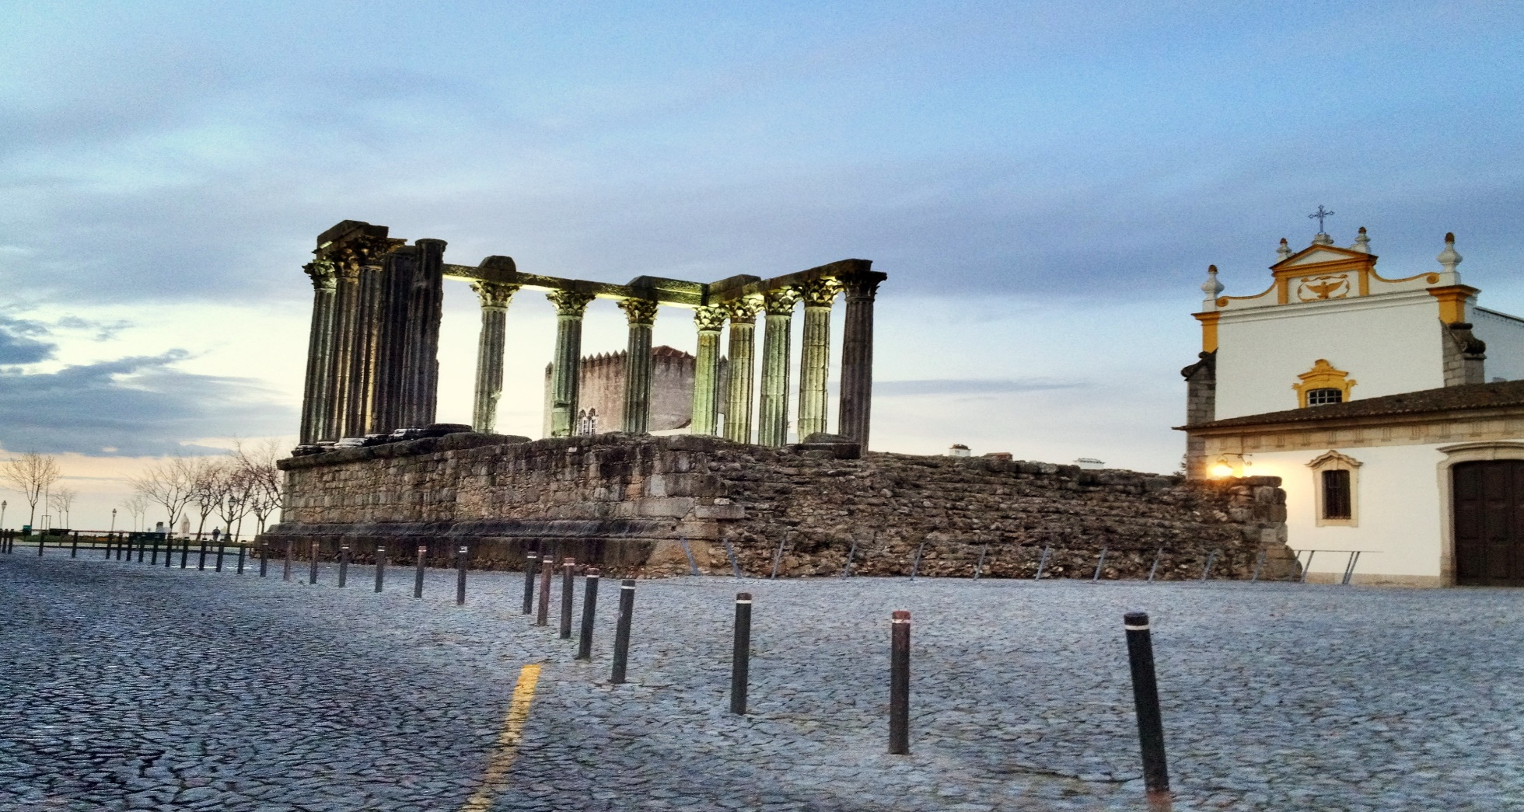
Évora
Roman remains

Slide 2
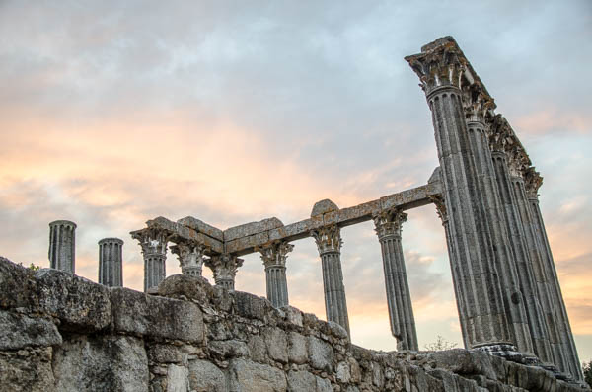
The Roman Temple of Évora would have escaped total demolition during the Christian era becausethe temple-turned-tower was used as a butcher shop.
The Temple of Évora

Slide 3
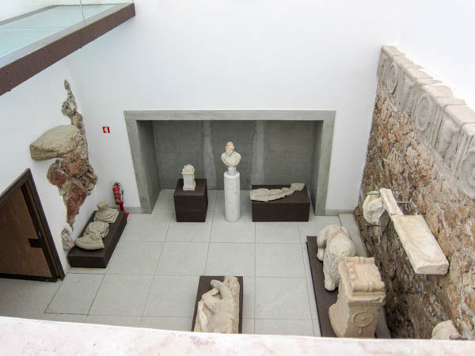
The Évora Museum
One of the main Portuguese museums, the Evora Museum houses numerous remains of our Roman heritage.

Slide 4
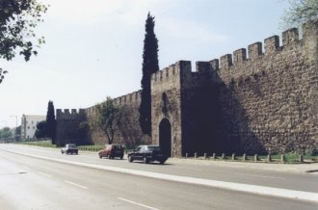
The walls of Évora castle
The walls of Évora castle are among the best preserved ones in Portugal. These defensive barriers were erected over the many centuries of the city's existence. Almost all the historic city is surrounded by these walls, with several doors and towers.

Slide 5
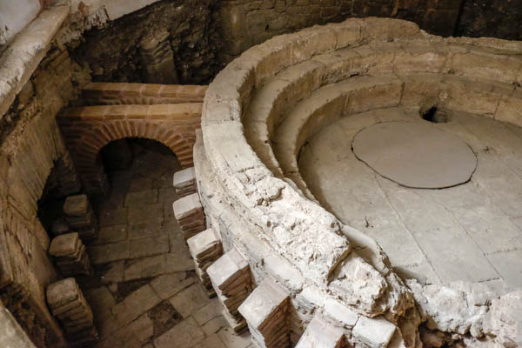
Discovered during the works in the County Palace (Évora City Council) in 1987, the Roman baths were built between the second and third centuries.
The Roman Baths

Slide 6
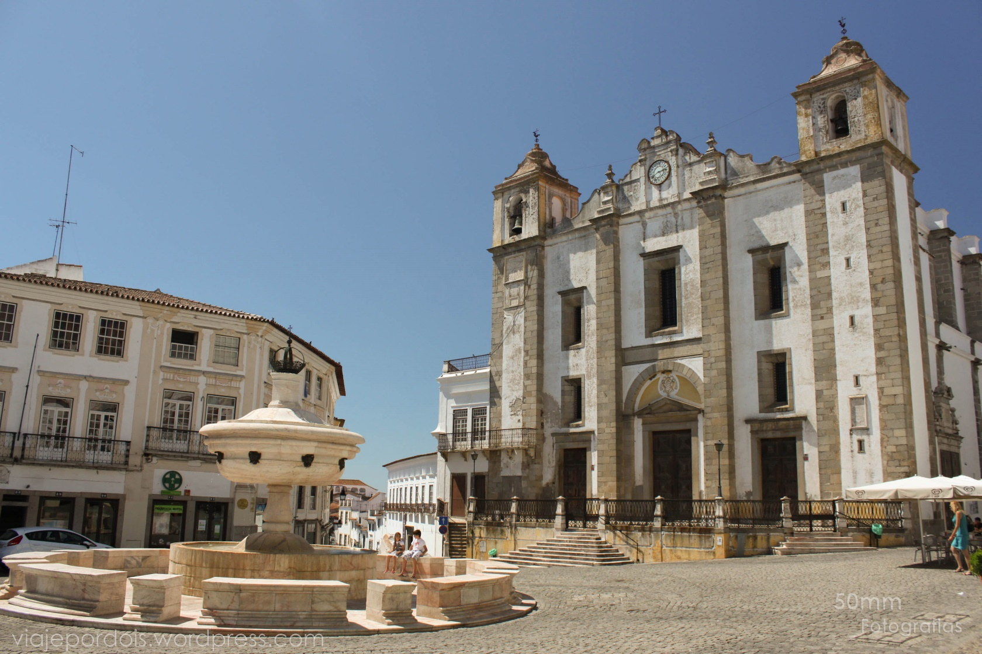
Praça do Giraldo (Giraldo Square)
In spite of having been destroyed in 1570, it is worth recalling the existence of a Roman arch, described in ancient sources as having three triumphal arches, columns, niches and statues.
The two statues of the Fountain of the Lions are Roman remains as well.

Slide 7
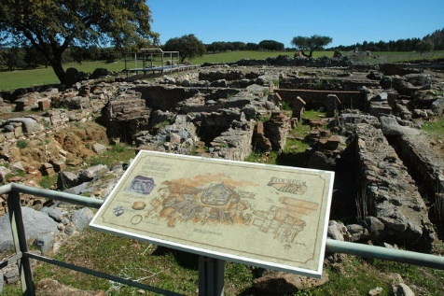
Villa Romana of Tourega
The Villa Romana of Tourega was situated in the territory of Ebora Liberalitas Julia. In the 4th century, it occupied an area of about 500 m2.
This archaeological site is part of a large spa complex, indicating the footprint that this would be a double spa (for both men and women), with rooms and tanks for hot and cold baths. The various archaeological materials found indicate that the villa was occupied from the 1st century until the end of the 4th century A.D.

Slide 8
Conclusion
We can see that Évora is a beautiful and historic city since it bears many traces of our past, for example, of the time when the Romans ruled over what is now Portugal. Actually, the Roman empire was so important that it managed to influence the whole European culture; therefore, our Roman Heritage must be preserved. After all, understanding our past helps us understand what we are today.

Slide 9
Bibliography
http://www2.cm-evora.pt/itinerarios/das_origens_sec_xii.htm
https://pt.wikipedia.org/wiki/%C3%89vora

Slide 10
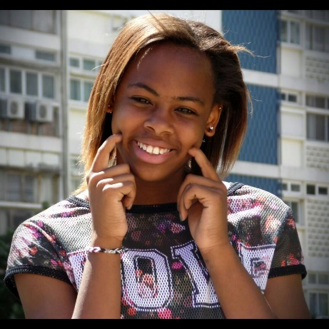

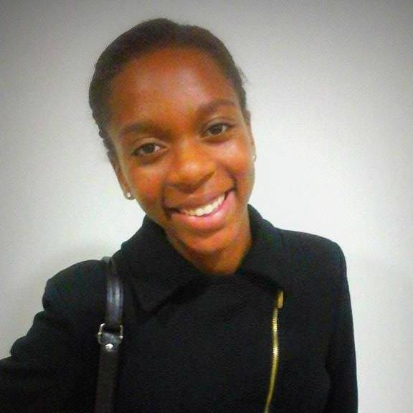
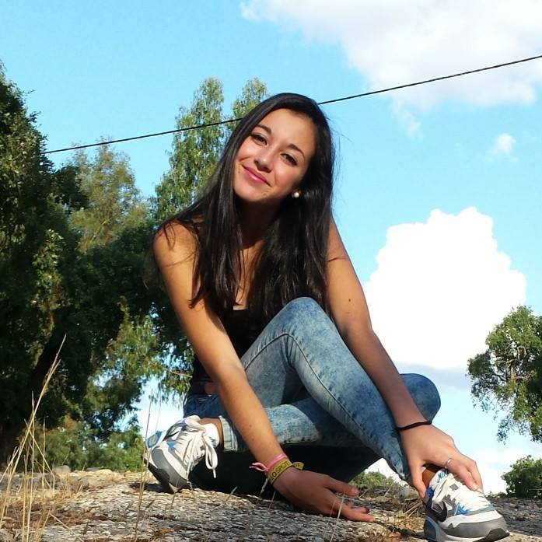
Work done by:
Ana Catarina do Rosário, no.1
Bruna Isabel Pereira, no. 5
Patrícia Rodrigues, no. 21
Raquel Ferraz, no. 23

Slide 11
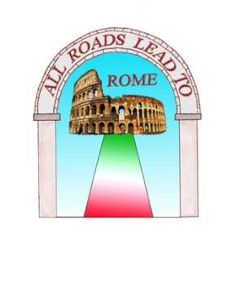

Erasmus+ Project All Roads Lead to Rome

