Slide 1
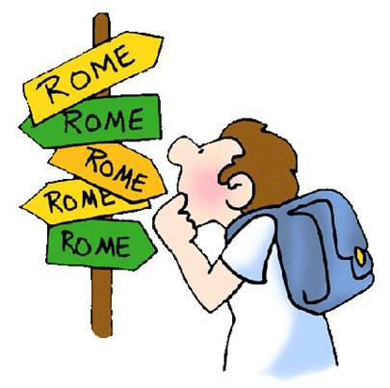
All Roads Lead to Rome
Joana Cardoso
10ºD Nº12

Slide 2
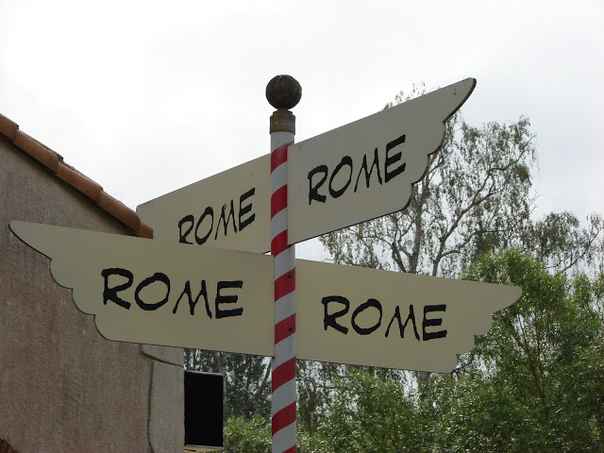
How and when it all began
The Iberian Peninsula was inhabited by many people and all of them left behind traces , techniques and knowledge. Vestiges left by the Romans were roads , bridges , monuments , Roman numerals , religion and Latin, the language from which Portuguese derives and which we speak today. For their own benefit and confort they built bathhouses, theatres, temples and statues. They help to found/develop various regions/towns such as Évora, Beja , Lisbon and Santarém.

Slide 3
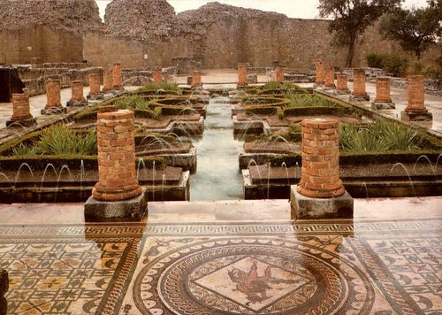
Conímbriga
The ruins of Conímbriga is the largest Roman settlements excavated in Portugal.
It is classified as a national monument.
It was occupied by the Romans in 139 B.C. and it was built in honour of Emperor Augustus.

Slide 4
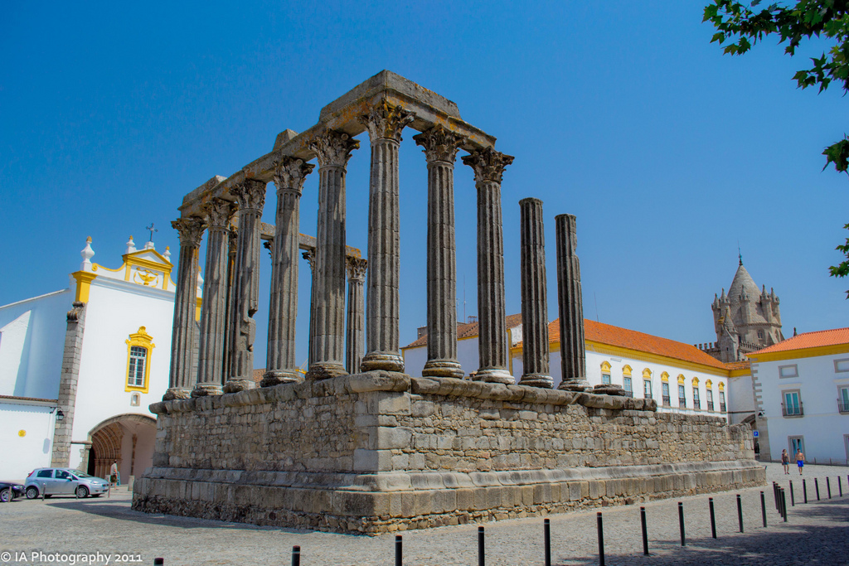
The Temple of Évora
The Roman Temple of Évora, which is also called Diana temple, was built in the first century A.C in the main square (forum) of Évora.

Slide 5
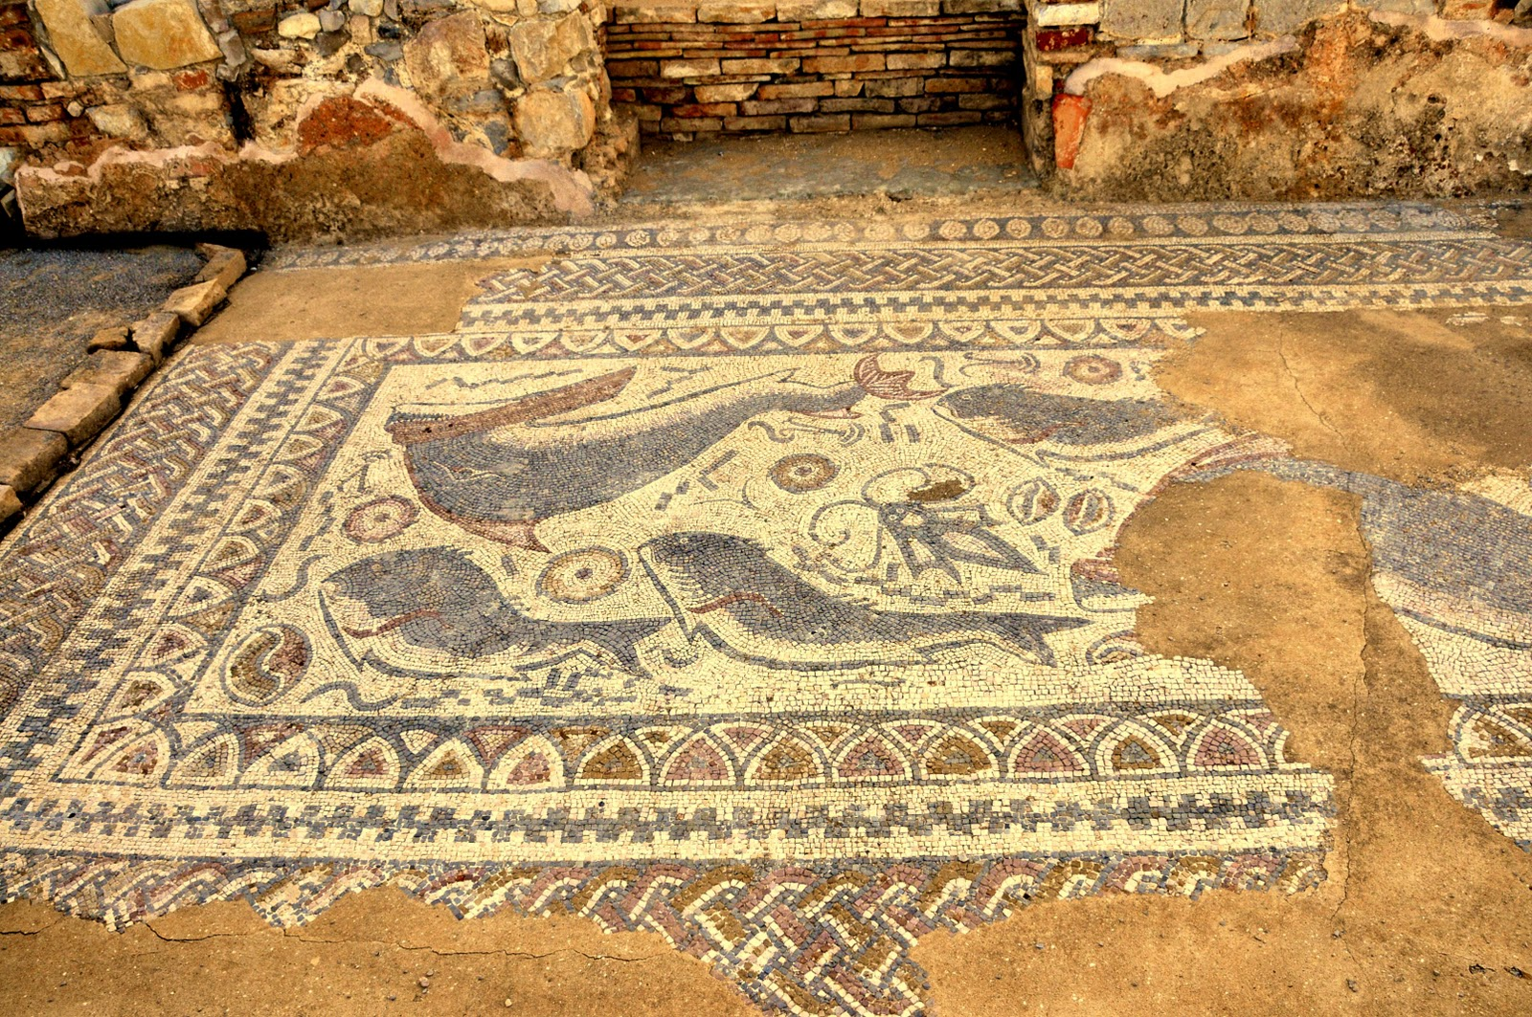
Milreu Roman Ruins
The Milreu Roman ruins are located in Estói, in the Algarve.
They were part of a larger complex that consisted of a villa, farm buildings, a Roman-style bath, a wine press, and a temple devoted to the pagans.
This Roman Villa was built in the 1st century and restored in the 2nd and 3rd centuries.

Slide 6
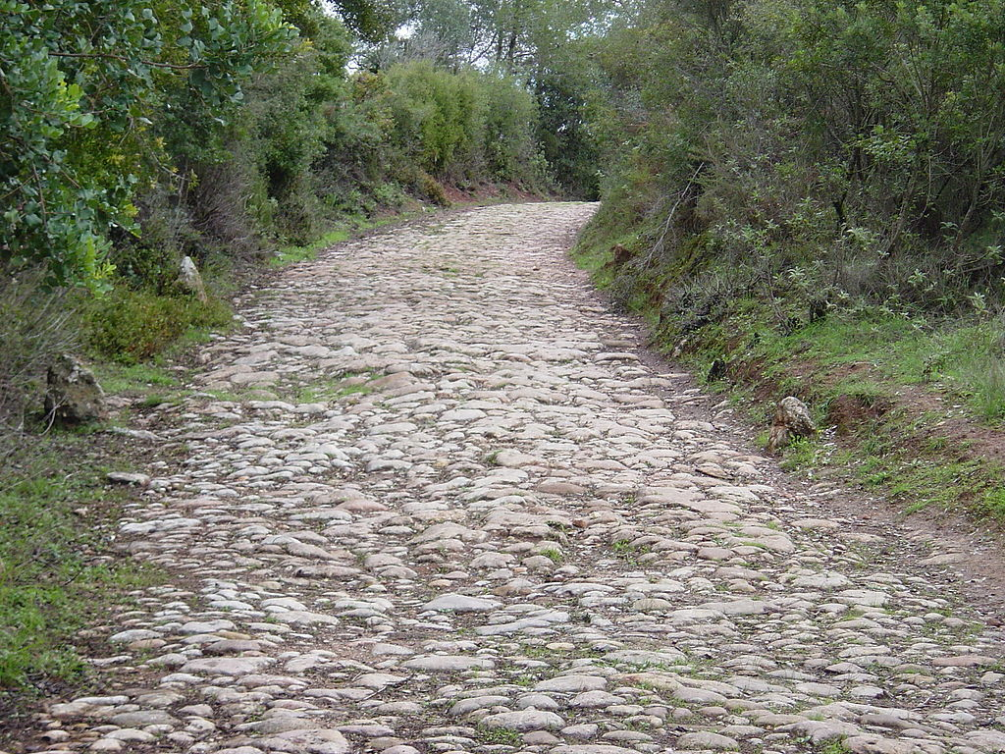
Viso’s Roman Road
Building roads facilitated communication and the movement of the Romans.
This piece of Roman road, which is about 2000 years old, is located in Grelhal, Setúbal. It is about 300 meters long.
It was part of one of the most important Roman roads because it connected important cities, for example, Olissipo (Lisbon) to Cantabria (Setúbal) and from there to Salácia (Alcácer do Sal) and Ébora (Évora) heading Emérita Augusta (Mérida, in Spain).

Slide 7
These are just a few examples of some of the Roman remains in Portugal. The Roman presence in our country lasted about seven centuries. They founded cities, built roads, bridges, and monuments, some of which still exist today; therefore our Roman heritage is present all over the country.

Slide 8

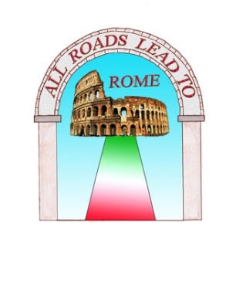

All Roads Lead to Rome

