Slide 1
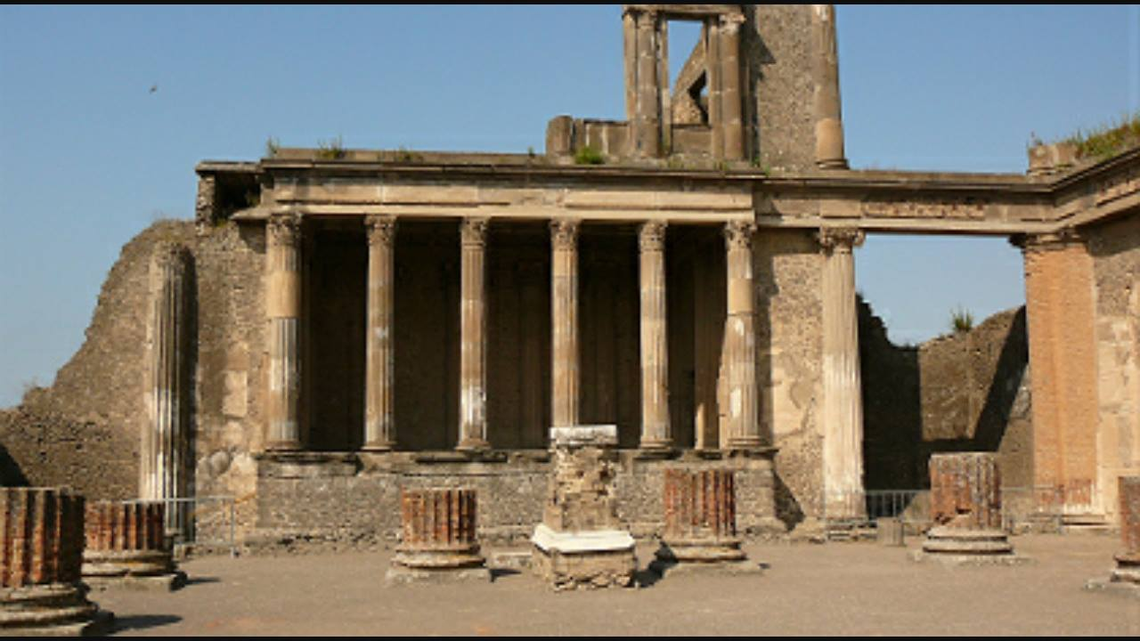
Roman Ruins in Portugal

Slide 2
Introduction
This work is about the Roman remains in our country.
First we will talk about the existing Roman ruins closer to us and then in the rest of Portugal.

Slide 3
Tróia
(Place closer to us)
In Roman times, a number of fish-salting factories were built next to the shore of Sado River. They produced large amounts of salted fish and fish sauces that supplied areas of Lusitania and were exported to Rome and other provinces of the Roman Empire. They were active from the first to the sixth century.
Tróia was part of the territory of Salácia, now known as Alcácer do Sal.
The first known archaeological excavations, which were sponsored by Infanta Maria I, date back to the second half of the eighteenth century. The excavations took place mostly in the residential area and over the area of the Basilica.
There we can also find extensive industrial structures, baths, a mausoleum and graveyards.

Slide 4
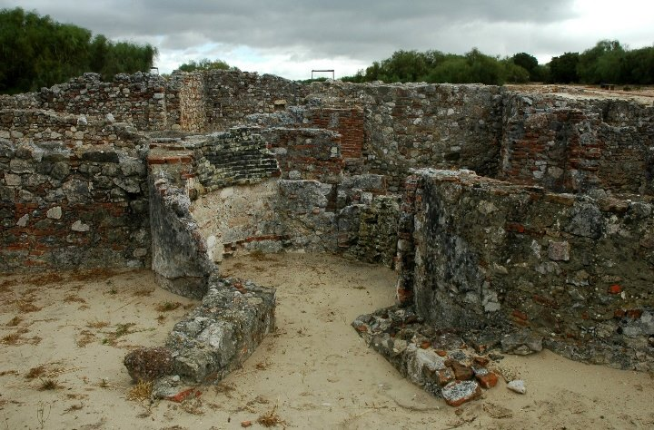
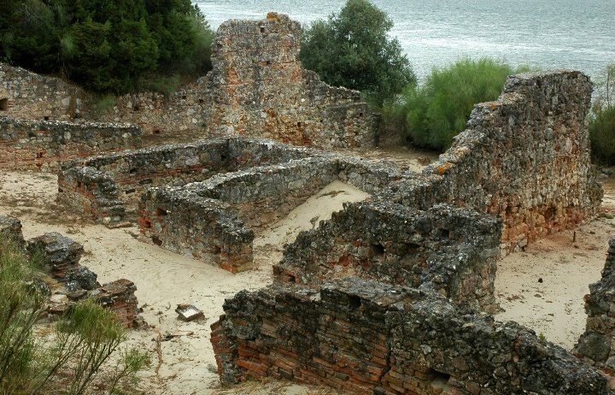
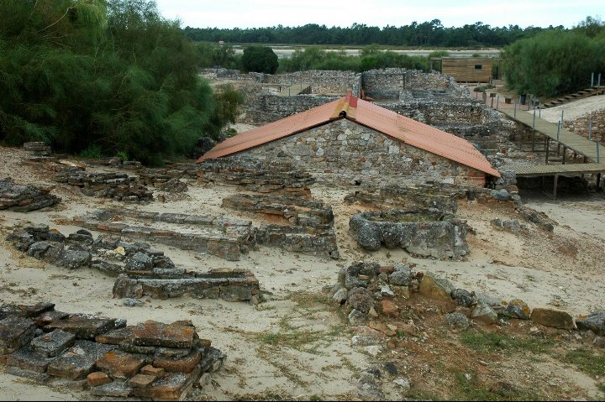
Tróia

Slide 5
Évora
The temple was built in the first century B.C. in the main square of Évora, in honour of the Emperor Augustus, who was venerated as a god, during and after his reign.
It was listed as a World Heritage Place by UNESCO.
This temple is one of the few traces of the Roman presence that still exist in Évora.

Slide 6
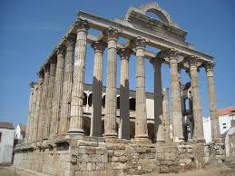
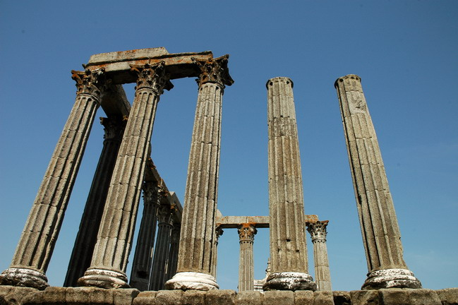
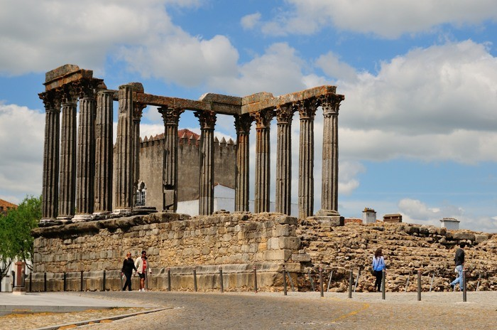
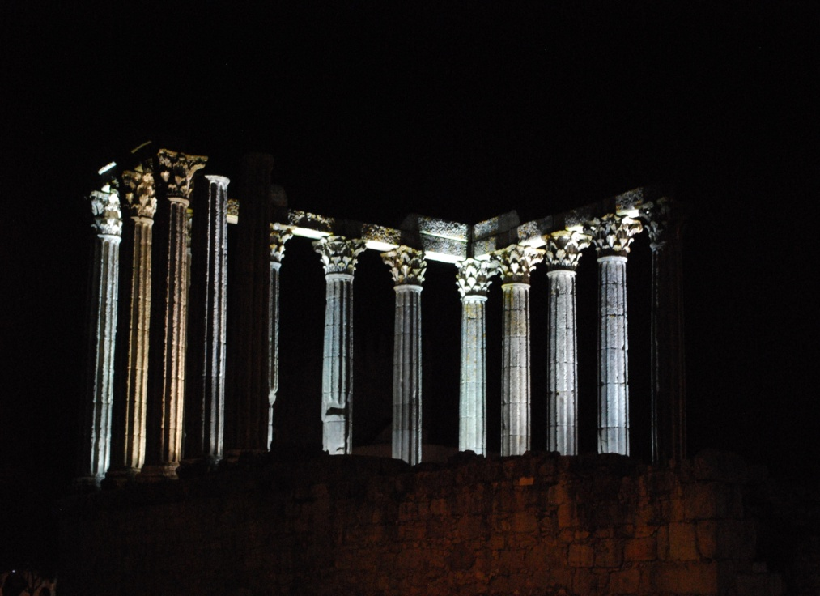
Temple of Diana

Slide 7
Belmonte
Tower centum cellas or formerly also known as tower of St. Cornelius.
This tower was dedicated to Pope St. Cornelius.
It was destroyed in a fire in the third century and then rebuilt. Currently it is a monument in ruins.
This monument was classified as a national monument in 1927.

Slide 8
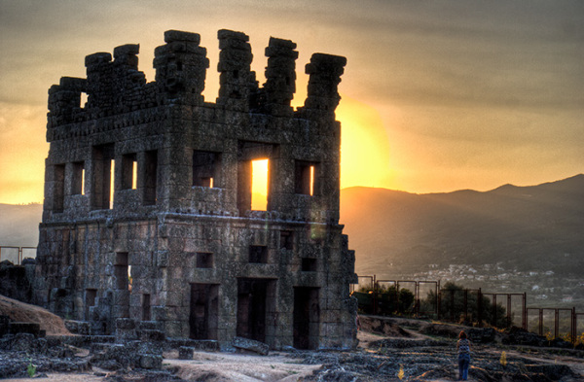
Tower of St. Cornelius

Slide 9
Chaves
At the time of the Roman occupation Chaves was known as "Aquae Flaviae", thermal springs, known for the quality of the thermal springs located there.
The springs were built by Emperor Vespasian Caesar order.
In Chaves we can find several vestiges of the Roman occupation such as the Roman bridge.

Slide 10
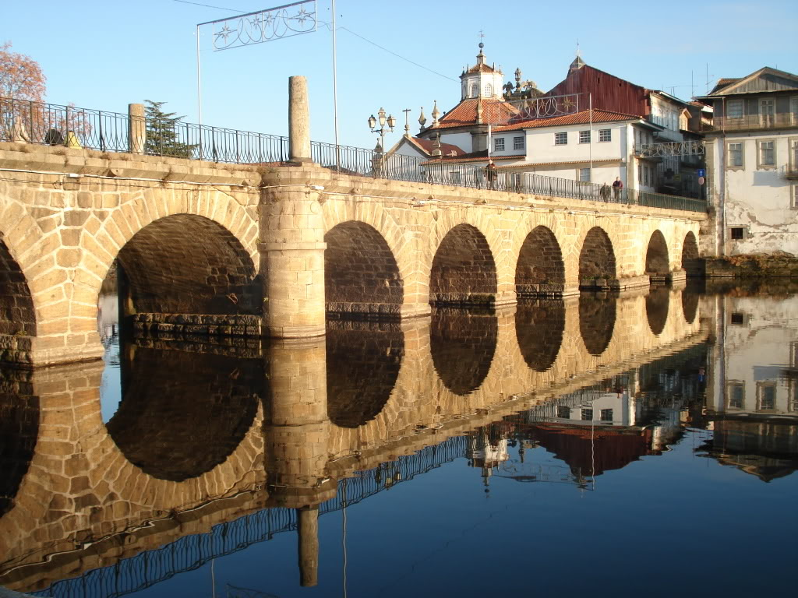

Slide 11
Coimbra
Conímbriga is located 16 kilometres away from Coimbra, in the parish of Condeixa-a-Velha.
The Emperor Augustus not only ordered the building of the Roman Temple of Évora, but also of Conímbriga.
Conímbriga is one of the largest Roman settlements excavated in Portugal.
It was the main city of Convento Escalabitano, a Roman Lusitanian province during the time of the Roman invasion in the Iberian Peninsula.
It was classified as a National Monument in 1910 and it is one of the best preserved archaeological sites in Portugal.

Slide 12
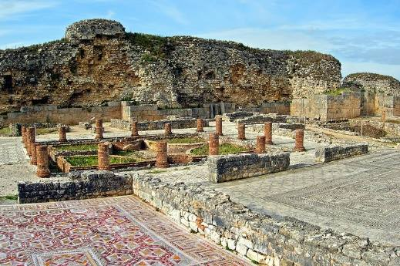
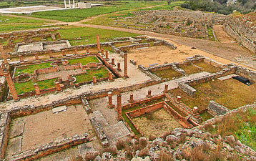
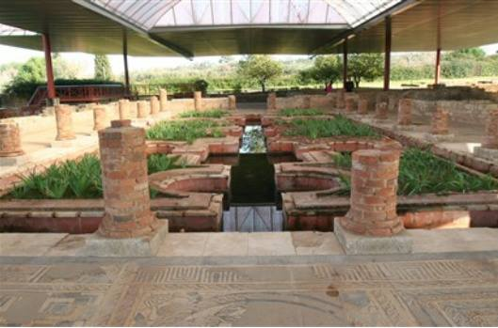
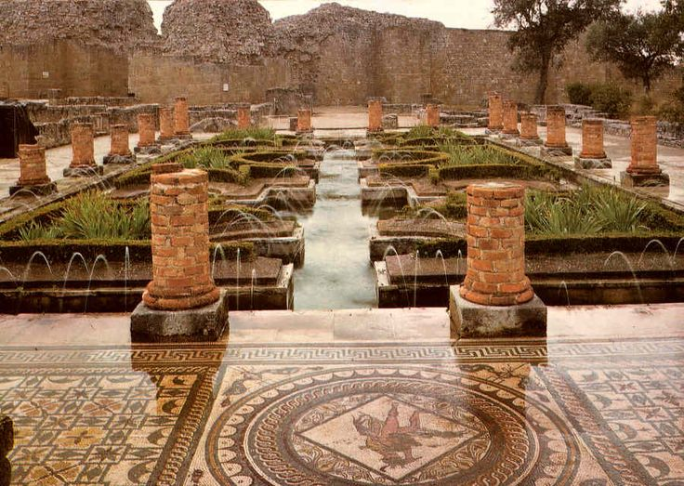
Conímbriga

Slide 13
Conclusion
We think that this work was very useful for us to get to know and learn more about our Roman heritage.
We talked about the Roman ruins of Tróia, because they are quite close to where we live, but we also talked about the Roman ruins in Évora, Belmonte, Chaves and Coimbra.

Slide 14
This work was done by:
  Pedro Henrique nº16
  Pedro Verde nº17
  Rafaela Carmo nº18
  Sara Vicente nº19
  Sara Gonçalves nº20
Teacher: Ângela Salgueiro
Subject: Citizenship Education
Class: 9ºD

Slide 15
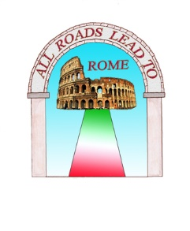

Erasmus+ Project All Roads Lead to Rome

