Slide 1
Social composition of prisons in England
Aye Ikomi

Slide 2
Prisons
Prisons can be referred to as social systems, they are a collection of people who are isolated from the majority of society and therefore may form their own norms and values outside of this majority.
The inmates and the staff could be representative of two different classes within this microcosm of society, with the staff holding power and assertion over the inmates.
Within the class of inmates there may be different smaller subsections which make up this group, they could be reffered to as subcultures and may have their own “rules”.
The number of prisoners in jail is at a record high of 87,501 (September 2011).
The number of offenders in jail has increased steadily over the past century and in 2008 the population exceeded the useable capacity of the prisons in England and Wales.

Slide 5
Ethnicity
The number of foreign nationals in prisons has increased over the past decade. It stood at 12.8% in March 2011.
Jamaica, the Irish Republic and Poland are the countries with the most nationals in prison establishments.
In June 2010 over one-quarter of the prison population whose ethnicity was recorded were from a minority ethnic group.

Slide 7
Women in jail
Although the number of inmates has increased the number of women in jails has decreased since last year, when it was 5%. At the end of june 2011 it stood at 2%.
The home affairs select committee said this in regards to female prisonsers: “The vast majority of these women are in prison for non-violent offences and have never been a danger to the public”
In a “Review of Women in the Criminal Justice System with Particular Vulnerabilities“, made by Baroness Jean Corston she said: “I was dismayed to see so many women frequently sentenced for short periods of time for very minor offences, causing chaos and disruption to their lives and families, without any realistic chance of addressing the causes of their criminality. The effects on the 18,000 children every year whose mothers are sent to prison are so often nothing short of catastrophic. I have concluded that the nature of women’s custody in many of our prisons needs to be radically rethought”

Slide 8
Young offenders
Yound offenders are those who fall into the age bracket of 15-20 years old, this is further split into juveniles who are between 15 and17 years old and young adults aged 18 – 20.
In June 2011 there were 1,581 juveniles in prison
There were also 278, children aged between 12 and 15 year olds in privately run secure training centres.
And also 172 in local authority secure children homes.

Slide 9
Type of offence

Slide 10
Prison Population PowerPoint
By Toby Blunsten

Slide 11
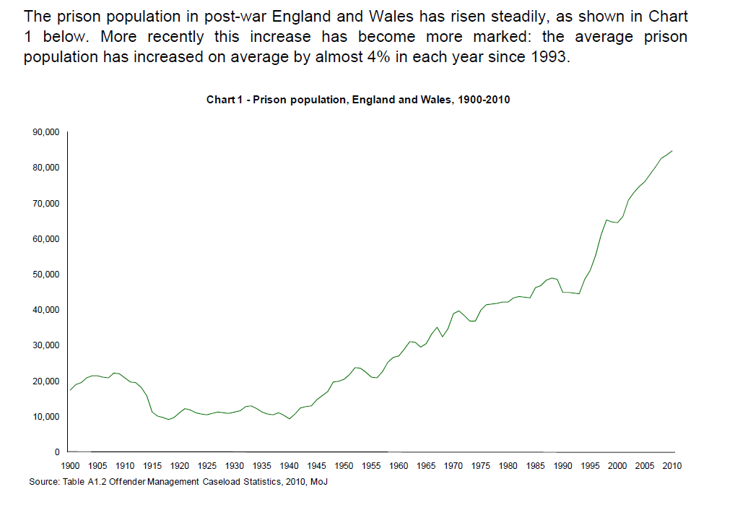
Rise In the Prison Population Total=87,501 approximately 1,000 places below the useable operational capacity of the prison estate.

Slide 12
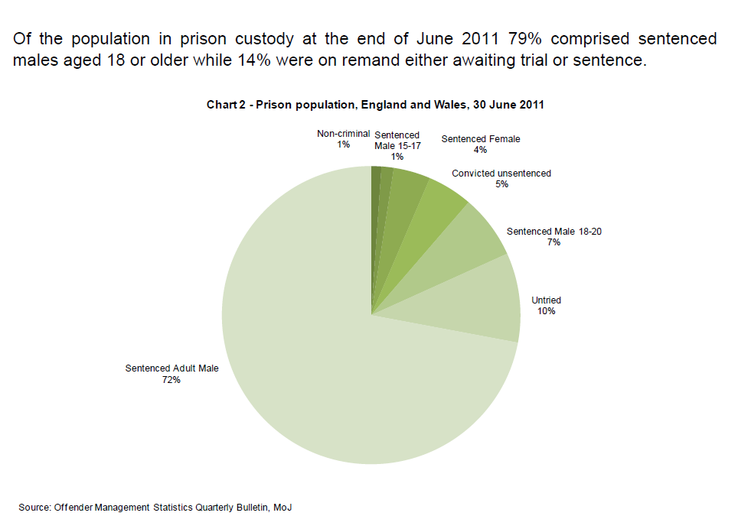
Convicted Prisoners in Prisons

Slide 13
Length of Sentence

Slide 14
Crime that is the reason for the sentence. (VATP means violence against the person)

Slide 15
Women In Prison
Approximately 4,200 females were in prison at the end of June 2011, 2% lower than the number in prison a year earlier, accounting for 5% of the prison population. Over the past decade the number of female prisoners has increased by almost one-third, a slightly higher rate increase of the male population.
The proportion of the prison population that are women rose steadily from the low of 2.5% in the late 1960s to a peak of 6.1% in 2002, the highest proportion since the late 1940s. In each year since 2002 the proportion of the prison population that are women has fallen.

Slide 16
Youths in Prison
Young prisoners are those prisoners aged between 15 and 20 years, the group being broken down into juveniles (15–17 years) and young adults aged 18 – 20.
At June 2011 there were 1,581 juveniles in prison, 330 of whom were awaiting trial and 100 awaiting sentence. The majority of juveniles in prison were under sentence. In addition to the juveniles in prison there were 278 12-15 year olds in privately run secure training centres and 172 in local authority secure children homes.
Of the 7,927 18-20 year olds in prison at June 2011 1,707 were remand prisoners either awaiting trial or sentencing. One half of the prison population aged 18 - 20 are prisoners sentenced to more than one year’s custody.

Slide 17
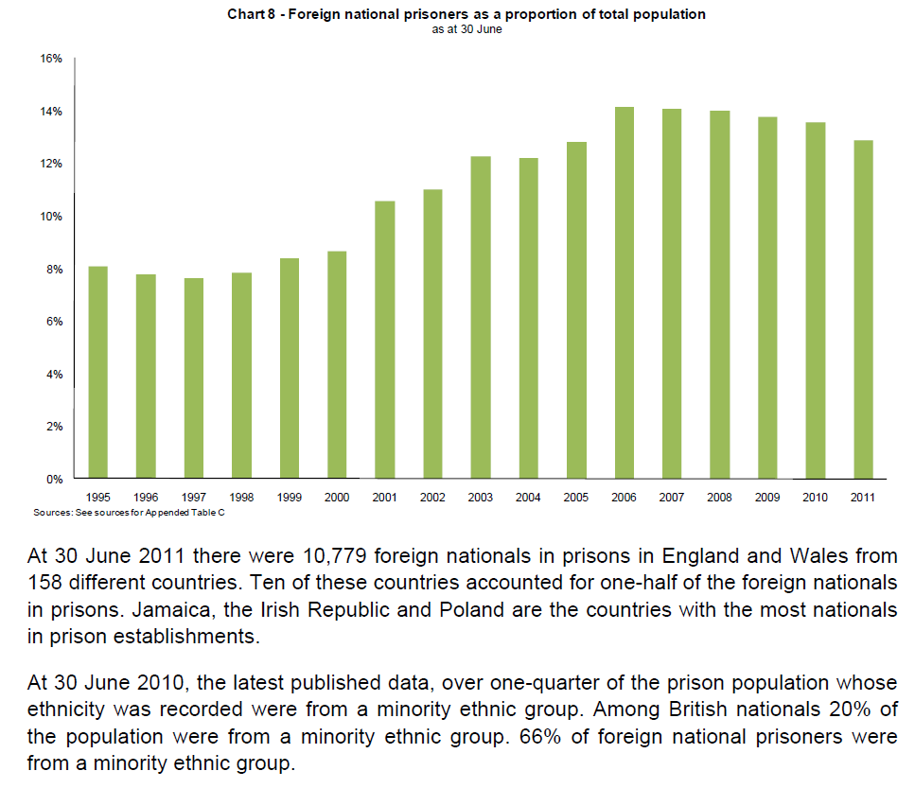
Foreign National Prisoners as a proportion to total population

Slide 18
Ethnic groups in prisons

Slide 19
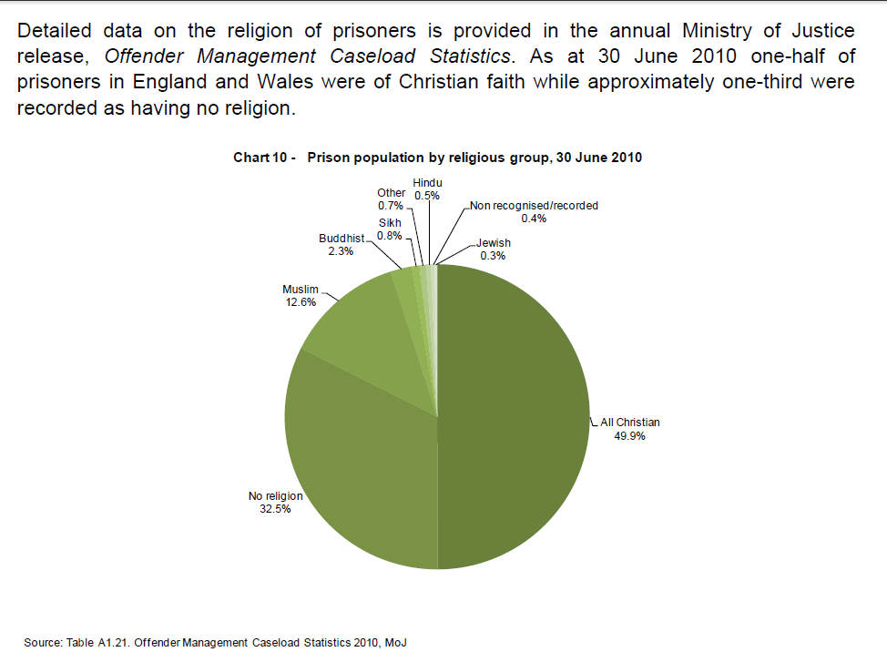
Religious groups in Prisons

Slide 20
Characteristics of Prisons
47% of male sentenced prisoners and 50% of female sentenced prisoners had run away from home as a child. This compares to 10% of the general population.
• Over 25% of prisoners had been taken into care as a child compared to 2% of the population.
• 43% of prisoners had a family member that had been convicted of a criminal offence. 35% had a family member that had actually been in prison.
• 81% of prisoners were unmarried prior to imprisonment, rising to 85% since imprisonment. Almost 10% had been divorced. These figures are twice as high as those found in the general population. (Hirschi and attachment???)
• One-quarter of young male offenders in prison are young fathers.
• One in five women prisoners were living at home with dependent children at the time of imprisonment.
• One-half of male and one-third of female sentenced prisoners were excluded from school. One half of male and seven out of ten female prisoners have no qualifications (alienated??).
• Two-thirds of prisoners have numeracy skills at or below the level expected of an 11 year old. One-half have a reading ability and 82% have writing ability at or below this level (low level of education, not socialised at school properly? Or correspondence theory?).
• Two-thirds of prisoners were unemployed in the four weeks before imprisonment.
• Around 70% of prisoners suffer from two or more mental disorders. In the general population the figures are 5% for men and 2% for women.
• Prisoners are more likely to be abusers of illegal drugs and alcohol than other sectors of the community. (alienated, Stuart hall?)
• Nearly three-quarters of prisoners were in receipt of benefits immediately before entering prison. (conservatives must love this)
• 5% of prisoners were sleeping rough prior and almost one-third were not living in permanent accommodation immediately prior to imprisonment.

Slide 21
Self Harm in Prisons
This publication comments on trends relating to self-harm and assaults up to the end of 2009. The underlying trends for each are assessed on changes to average annual rates.
The prison population increased by just under 1,000 between June 2008 and June 2009. However, both self-harm incidents and assault incidents fell between 2008 and 2009. This follows peaks in both series in 2008.
Self-harm incidents per thousand of the prison population decreased from 305 to 290 from 2008 to 2009. The number of individuals self-harming increased between 2008 and 2009 from 6,458 to 6,977. There is however a marked difference between male and female prisoners: around 7 per cent of male prisoners self-harm compared to over a third of female prisoners.
The number of assault incidents per thousand of the population decreased from 195 to 180 between 2008 and 2009. In 2009, 1,319 of 15,180 total assault incidents or 9% were classified as serious. There were 2,873 assaults on staff (19% of all assault incidents).

Slide 22
Statistics of Self-harm

Slide 23
Bibliography
www.parliament.uk/briefing-papers/SN04334.pdf
http://www.statistics.gov.uk/hub/crime-justice/offenders/prison

