Slide 1
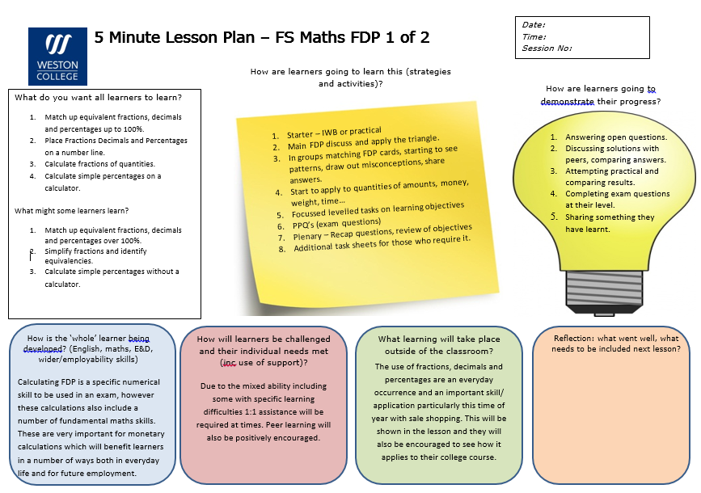

Slide 2
`

Slide 3
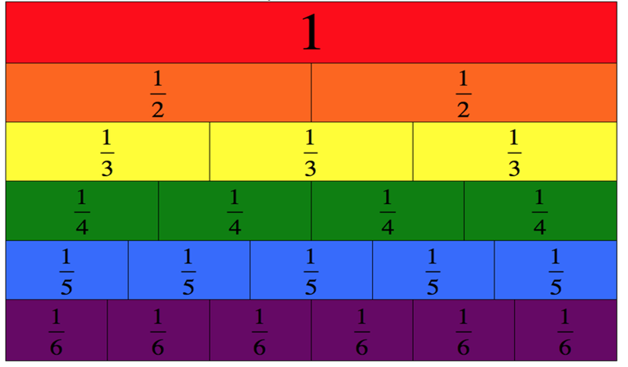
Fractions, Decimals and Percentages
Application and Exam practice

Slide 4
Learning Objectives
Match up equivalent fractions, decimals and percentages
Place Fractions Decimals and Percentages on a number line
Calculate fractions of quantities
Calculate simple percentages on a calculator

Slide 5
The FDP Triangle
This simple triangle is a very good way of remembering how to convert between fractions decimals and percentages.
Using the 3 headings (fractions, decimals and percentages) if you can remember 1 worked example you can do any calculation.
Notes:
See notebook file (build your own triangle) drag and drop. Or premade.

Slide 7
Card Sort
Match up equivalent fractions, decimals and percentages.
You may find it easier to use your triangle!

Slide 8
Placing the values on a number line
Hint: the FDP triangle
0%
100%
0
1

Slide 9
Fractions of Quantities
1/4 of 24
3/4 of 36
1 ÷ 4 =
x 24 =
division
multiply
3 ÷ 4 =
x 36 =

Slide 10
Fractions of Quantities
Calculate the fractions of the quantities shown.
1
1
1
1
2
3
of 30 kg
of 54 mm
of 120 g
5
6
10
6 kg
9 mm
12 g
4
5
6
1
4
5
of 60 cm
of 30 kg
of 48 mm
3
5
6
20 cm
24 kg
40 mm
7
8
9
2
7
13
of 90 cm
of £36
of $180
3
9
20
60 cm
£28
$117

Slide 11
%’s on a calculator
You can find any % on a calculator
How do you convert a % into a decimal?
24% = 0.24
24% of £50
0.24 x 50 =

Slide 12
Past exam papers

Slide 13
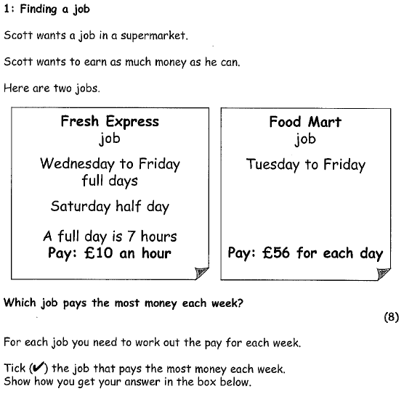
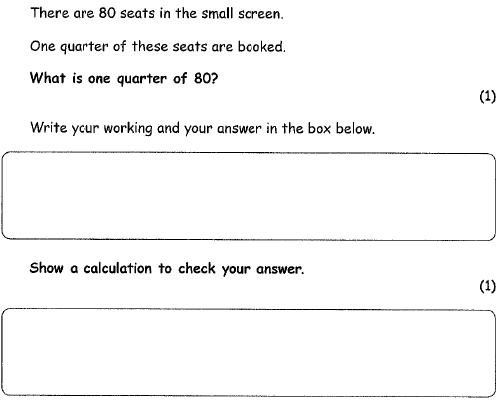
Entry 3

Slide 14
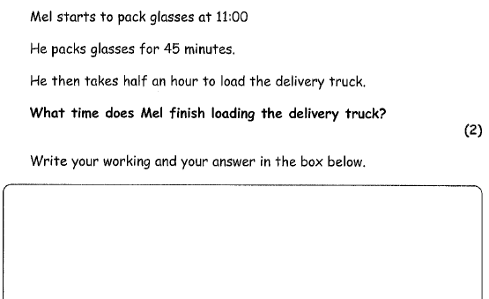
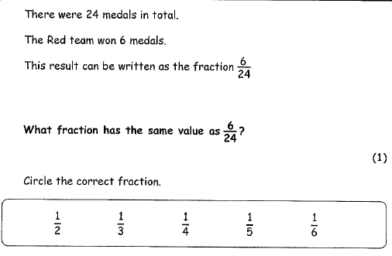
Entry 3

Slide 15
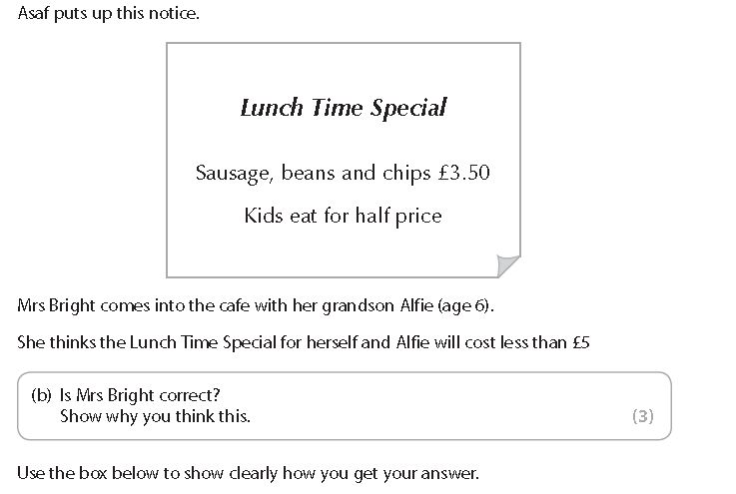
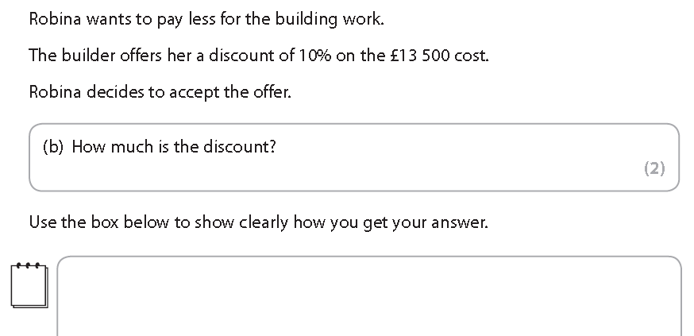

Slide 16
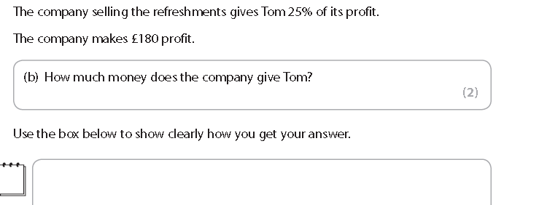
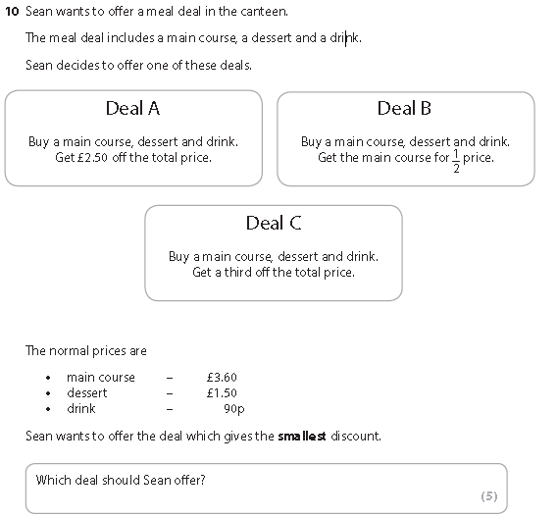
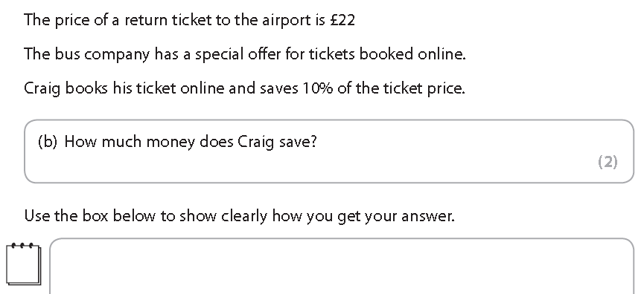

Slide 17
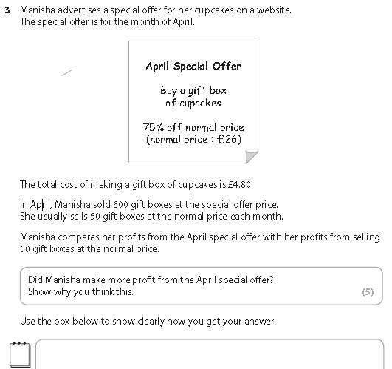

Slide 18
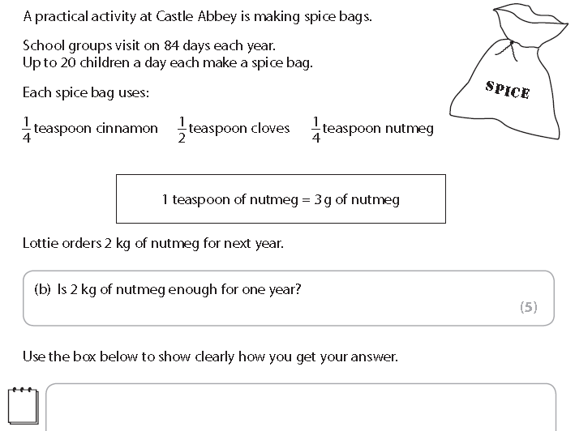
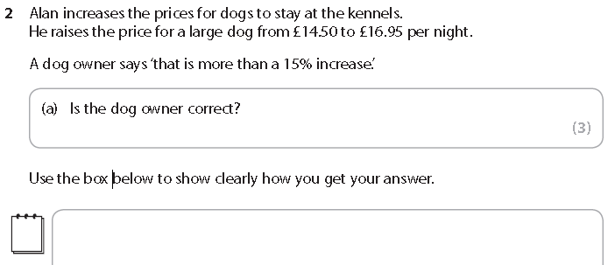

Slide 19
What have you learnt?
Draw the FDP triangle without looking at your notes
Draw a number line and place at least 1 fraction, decimal and a percentage
What is 2/5 of £300
Show your workings
Demonstrate how to calculate 82% of £250

Slide 20
1/8 | 1/20 | ½
5/8 | 13/100 | 3/4
1/3 | 9/10 | 1/10
2/3 | 3/2 | 1/5
7/10 | 5/4 | 1/4
1/100 | 1/1 | 2/5
Fractions

Slide 21
0.125 | 0.05 | 0.5
0.625 | 0.13 | 0.75
0.33333... | 0.9 | 0.1
0.6666..... | 1.5 | 0.2
0.7 | 1.25 | 0.25
0.01 | 1 | 0.4
Decimals

Slide 22
12.5% | 5% | 50%
62.5% | 13% | 75%
33.3333..% | 90% | 10%
66.6666....% | 150% | 20%
70% | 125% | 25%
1% | 100% | 40%
Percentages

Slide 23
Blanks – Use these to make your own different FDP card sets

Slide 24
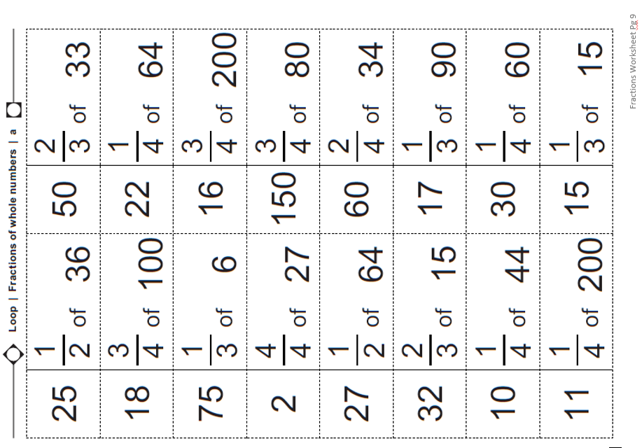

Slide 25
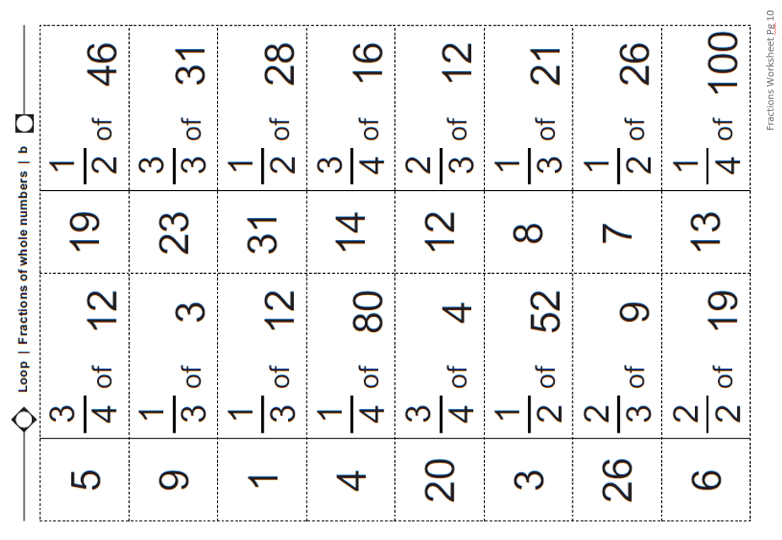

Slide 26
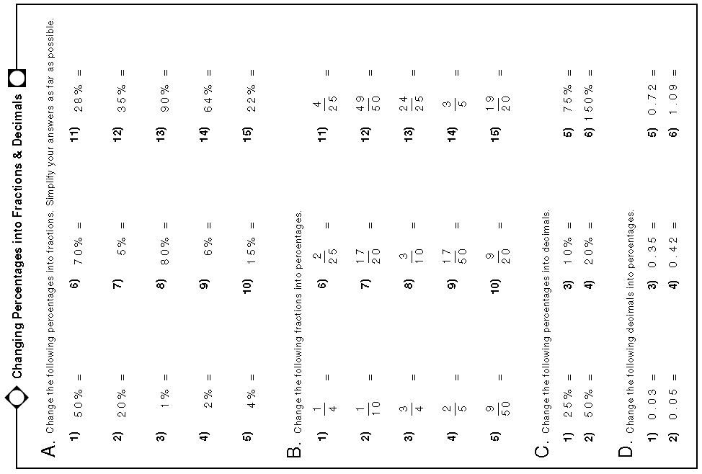

Slide 27
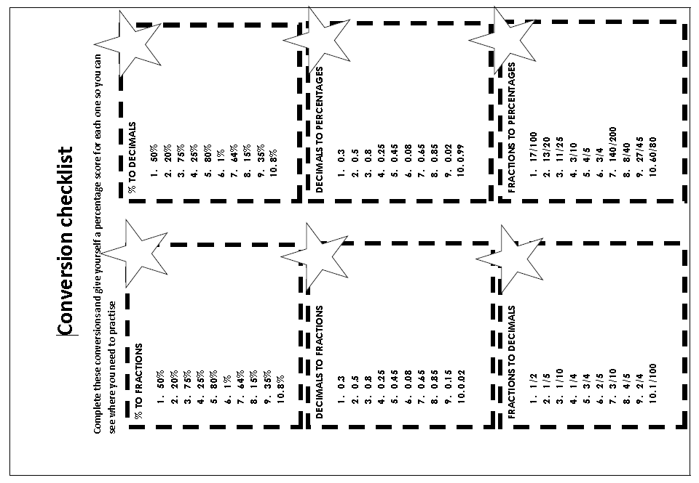

Slide 31
Fractions, Decimals and Percentages
Application and Exam practice

Slide 32
Objectives:
Find fractions of quantities.
Add or subtract decimals up to 2dp.
Round decimals or amounts of money.
Use common fdp equivalences to find solutions to practical problems.
Use equivalent fdp’s to solve practical problems.
Find common fractions or percentages of quantities to solve practical problems.

Slide 33
Notes:
75*5=375+3+1=379

Slide 34
Once you have done this swop your work with someone else. Look at their order and explanation.

Slide 35
Is this correct?
0.375, 0.125, 0.75, 0.25, 0.04, 0.4, 0.8
I know this because they work like fractions, 0.4 is like a
quarter. The more digits there are, the smaller the decimal is.

Slide 36
Is this correct?
0.125, 0.375, 0.04, 0.25, 0.75, 0.4, 0.8
Tenths are bigger than hundredths and thousandths, so
longer decimals are smaller.

Slide 37
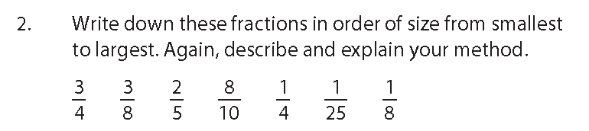
Again, compare your order with someone else. Are they the same, did you use the same method, discuss.

Slide 38
Now get into groups of 2 or 3 learners. No more than 3 in a group.

Slide 39
You will now be given some cards (Card sets A, B, C and D).
Take it in turns to match pairs of cards and place them on the table, side by side (not on top of one another).
As you do this you must explain how you know that the cards make a pair.
Others in the group should either challenge what they have said or say why they agree.
Try to explain carefully why pairs of cards match each other.
If learners are struggling there are simpler card sets to start with (E&F).

Slide 40
When your group are happy with your final matching place the cards in order of size, smallest to largest.
Too simple? Try this:
If this was too easy now try making your own cards that fit between the pairs you have put in order.
Now revisit the answers you wrote down at the beginning of the lesson. Did you make any mistakes? Write down and explain any faults in your initial reasoning.

Slide 41
Show me…

Slide 42
Show me…

Slide 43
Show me…

Slide 44
Show me…

Slide 45
Show me…

Slide 46
Show me…

Slide 47
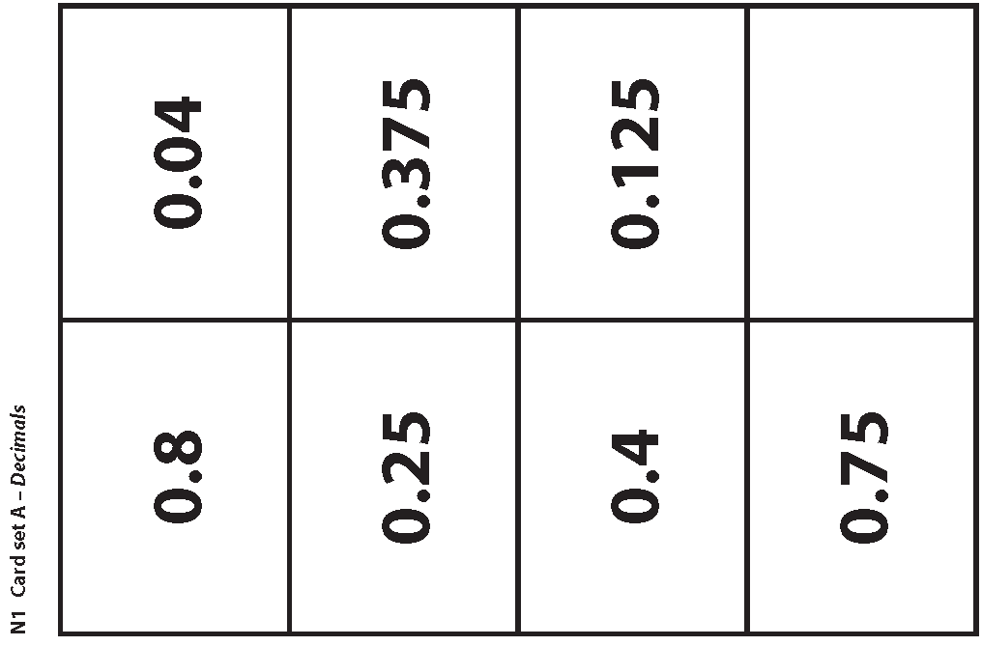

Slide 48
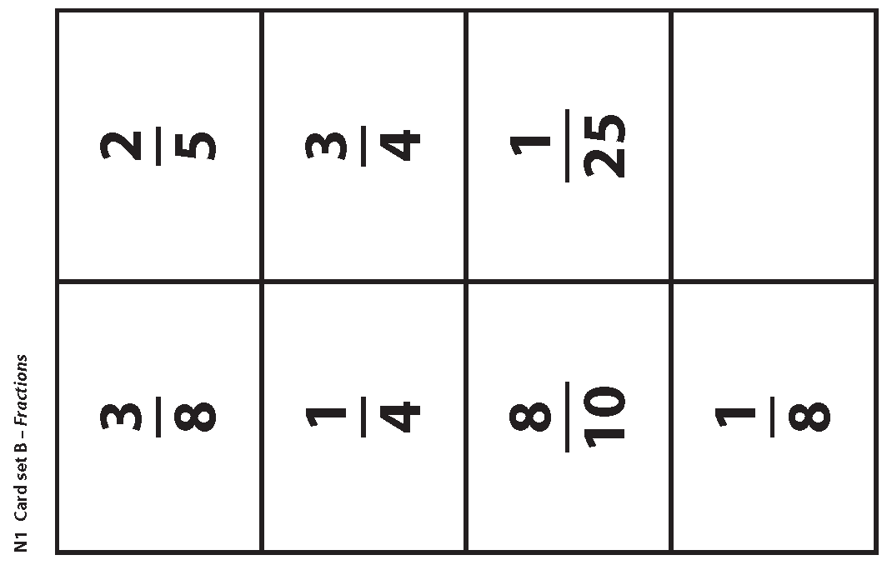

Slide 49
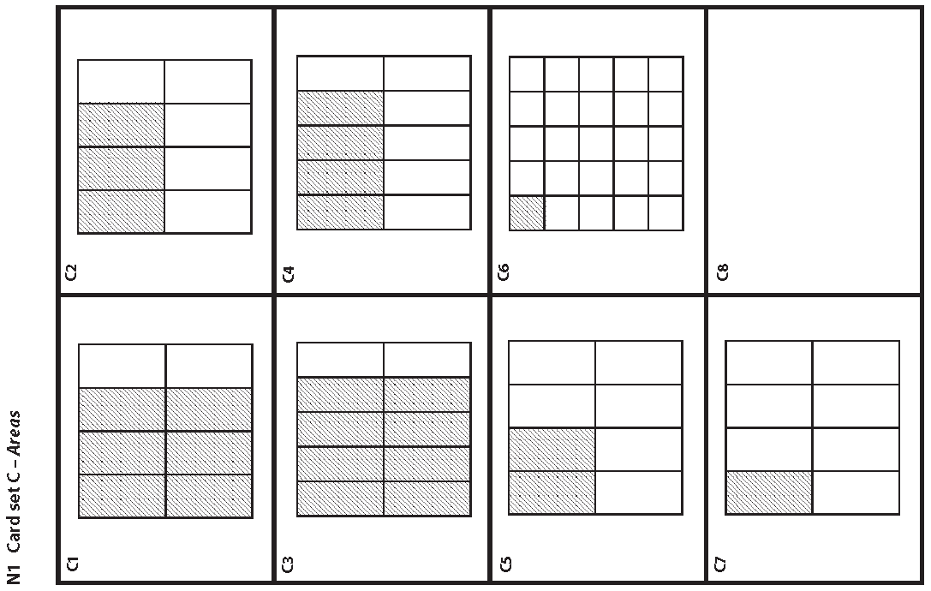

Slide 50
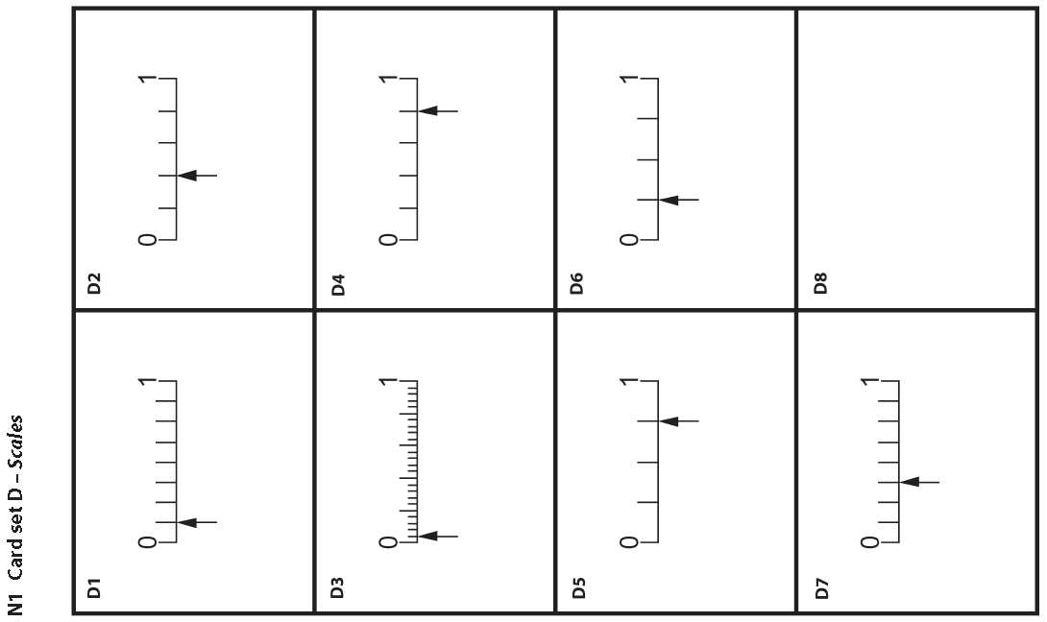

Slide 51
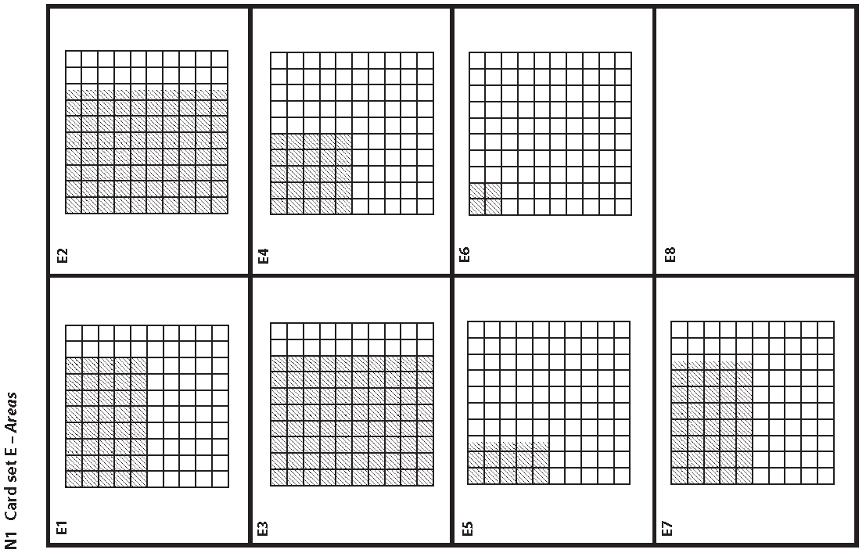

Slide 52
