Slide 1
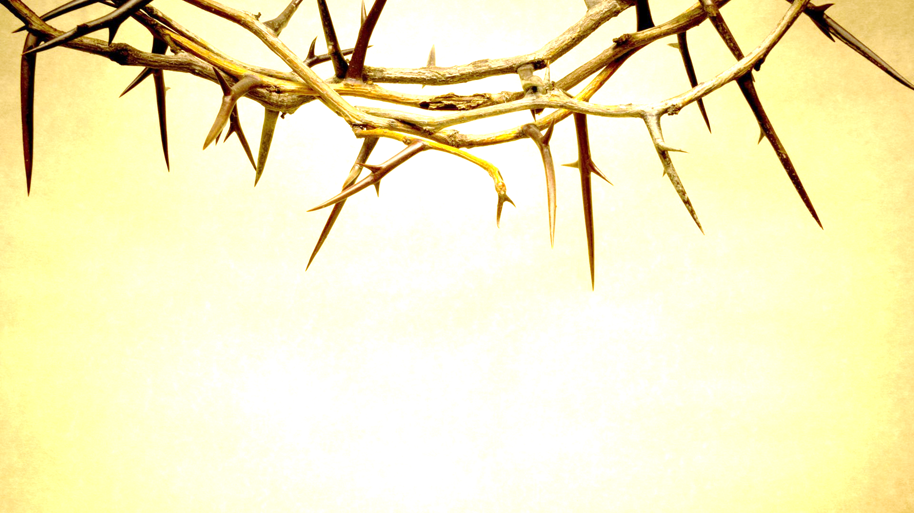
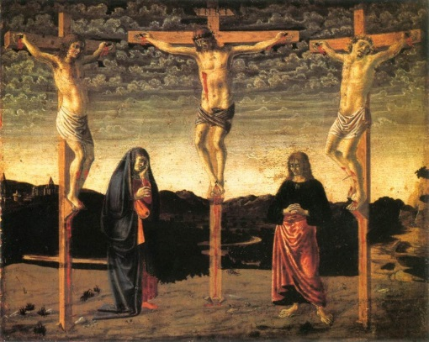
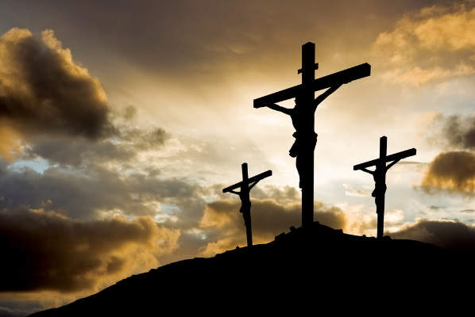
Good Friday
WALT: analyse the role of religion and feminism in Good Friday.

Slide 2
CONTEXT
Rossetti’s ideas about religion
Rossetti’s attitudes towards women

Slide 3
Good Friday Wiki
Good Friday is a Christian holiday commemorating the crucifixion of Jesus Christ and his death at Calvary. It is observed during Holy Week as part of the Paschal Triduum on the Friday preceding Easter Sunday, and may coincide with the Jewish observance of Passover. It is also known as Holy Friday, Great Friday, Black Friday,^{[1][2][3]} or Easter Friday,^{[4][5]} though the last term properly refers to the Friday in Easter week.

Slide 4
Good Friday is a Holy Day commemorating the crucifixion of Jesus Christ at Calvary. The Easter celebration is the most important in the Christian calendar, as it’s the point at which Jesus died to redeem Mankind.

Slide 5
Symbolism
Am I a stone and not a sheep That I can stand, O Christ, beneath Thy Cross, To number drop by drop Thy Blood's slow loss, And yet not weep? Not so those women loved Who with exceeding grief lamented Thee; Not so fallen Peter weeping bitterly; Not so the thief was moved; Not so the Sun and Moon Which hid their faces in a starless sky, A horror of great darkness at broad noon— I, only I. Yet give not o'er, But seek Thy sheep, true Shepherd of the flock; Greater than Moses, turn and look once more And smite a rock.
Feminism
Religion

Slide 6
AVERY:
A major influence and drive for Rossetti’s writings was her devout religious belief. As the sister of the painter-poet Dante Gabriel Rossetti (1828-82), Rossetti was at the centre of the Pre-Raphaelite movement in the mid-to-late Victorian period, a radical group which challenged conventions about art in many ways. She was sometime model for her brother’s paintings – significantly being painted as the Virgin Mary in The Girlhood of Mary Virgin (1848-9) and Ecce Ancilla Domini! (1850) – but she quickly became the movement’s lead poet. Her strong religious beliefs nevertheless marked her out from the majority of the other Pre-Raphaelites.
Indeed, while Dante Gabriel would become more free-thinking and withdraw from established belief, Christina, along with her sister Maria and their mother Frances, maintained a strong commitment to High Anglicanism. Worshipping at Christ Church, Albany Street (London) from the early-1840s, the Rossetti women came under the influence of the Oxford Movement, with its increased emphasis on rituals such as confession and communion. Maria would eventually become an Anglican nun in 1873 and Christina would work for some time with the Anglican sisterhood at the St Mary Magdalene Penitentiary, Highgate, helping prostitutes escape their lives on the streets by retraining them for domestic service. Moreover, Christina would turn down two potential suitors, James Collinson and Charles Bagot Cayley, on the grounds of religious incompatibility.
http://www.bl.uk/romantics-and-victorians/articles/christina-rossetti-religious-poetry

Slide 7
Religious Contextual Information
The Book of Exodus describes how, whilst he was leading the people out of Egypt and towards the Promised Land Moses received a lot of complaints. The people were not happy as they were incredibly thirsty and tired. In a state of exhaustion, Moses asked God what he was to do next.
The LORD answered Moses, ‘Go out in front of the people. Take with you some of the elders of Israel and take in your hand the staff with which you struck the Nile and go. I will stand there before you by the rock at Horeb. Strike the rock and water will come out of it for the people to drink'. So Moses did this in the sight of the elders of Israel. Exodus 17:5-6. TNIV
In Good Friday, Rossetti's speaker imitates the exhausted and desperate tone of Moses in pleading with Christ to ‘turn and look once more' and ‘smite a rock', enabling him/her to feel again (lines 15-16). There is the unspoken hope that, as water emerged from the rock at Horeb after it was struck, so will the speaker's emotions.

Slide 8
STRUCTURE AND FORM
Short lines to end each stanza; each emphasizes the difficulty the speaker is experiencing and their lack of understanding of their own response
Rhyming couplets in the middle of the first two stanzas suggest the trapped feeling of the speaker as they’re trying to break out and fully experience their emotions. The change in stanza three, removing the rhyme but retaining the iambic pentameter, suggests that the speaker is beginning to experience, and come to terms with the way that they experience God
Iambic rhythm for the most part emphasizes key words – “I”, “stone”, grief”, “loss” and so on.
Interruption of “I, only I is a changed rhythm, and emphasizes the fact that the speaker’s the only one who can look on what is happening.

Slide 9
CRITICAL INTERPRETATIONS
“Good Friday is a passionate outcry against the easy indifference with which man can think of the Christ who bore our shame in agony”.
Myra Reynolds, 1898

Slide 10
CONNECTIONS
Religion – Twice; Up-hill; Shut out
Doubt – Twice, Remember
Natural Imagery – Goblin Market; Shut Out; Maude Clare

