Slide 1
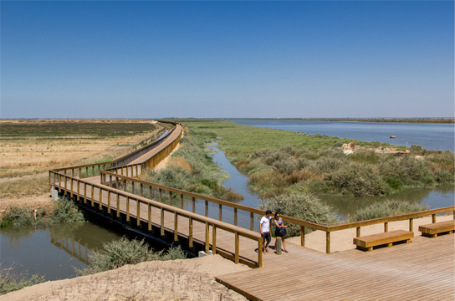
Let’s explore an ecosystem near us.
Our Riverfront area
Póvoa de St. Iria

Slide 2
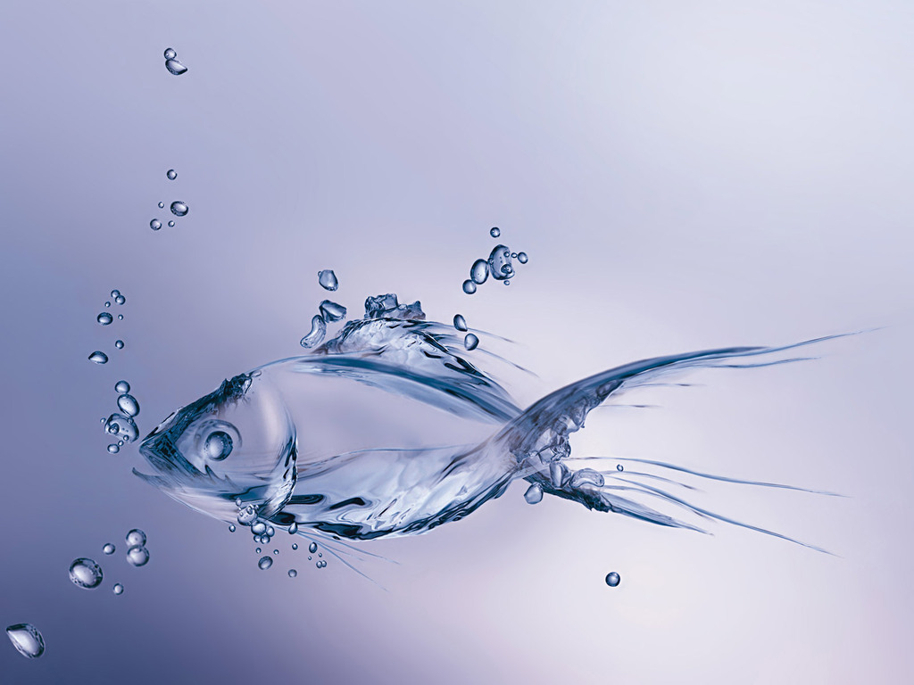
Fauna

Slide 3
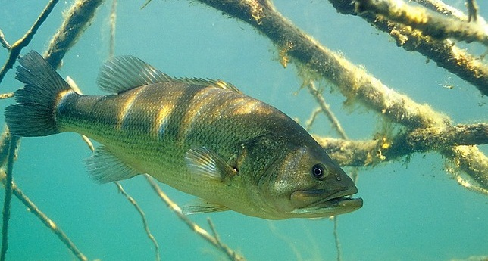
Fish

Slide 4
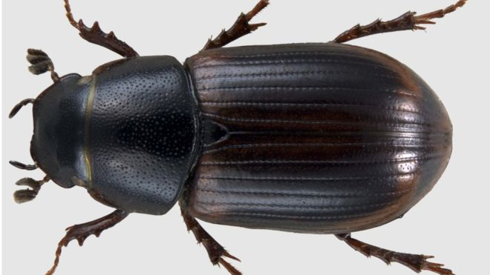
Beetle

Slide 5
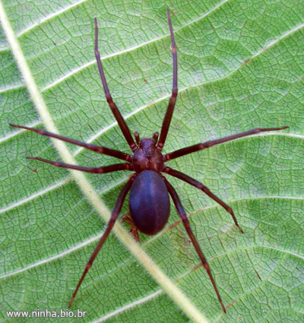
Spider

Slide 6
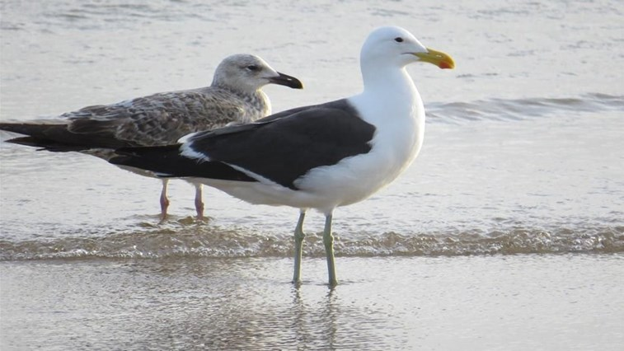
Seagull

Slide 7
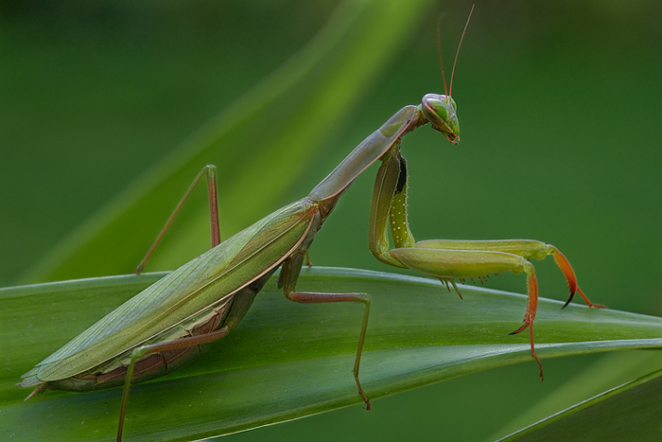
Praying mantis

Slide 8
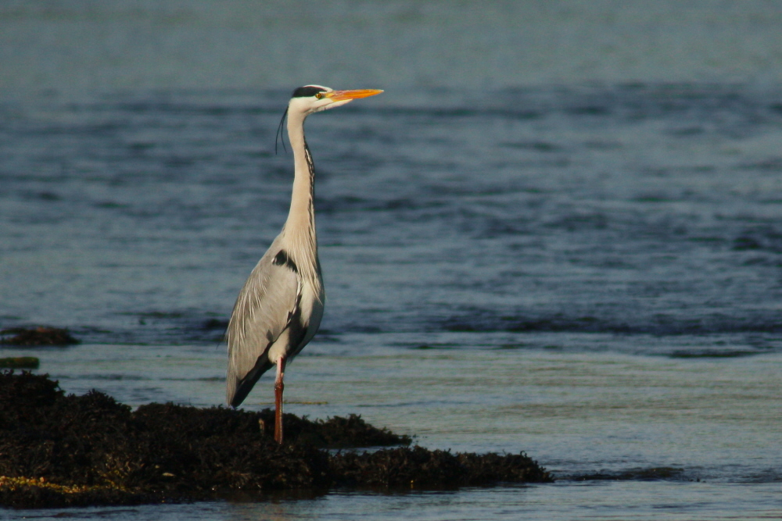
Heron

Slide 9
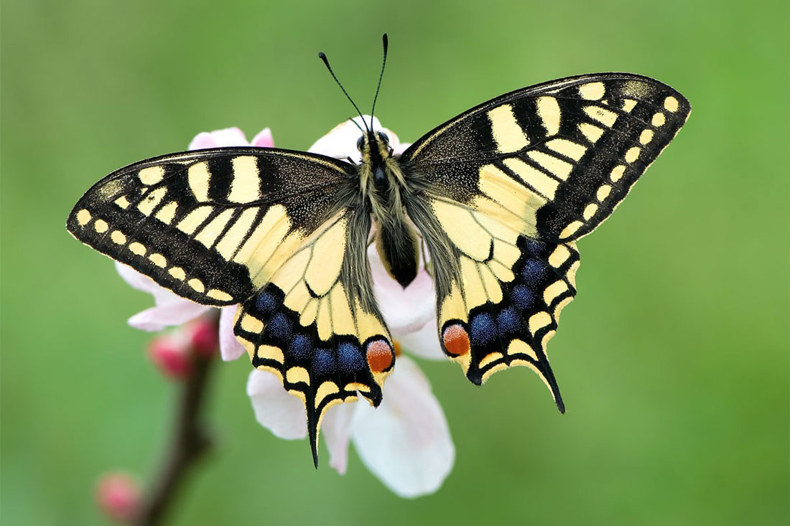
Butterfly

Slide 10
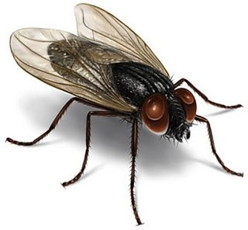
Fly

Slide 11
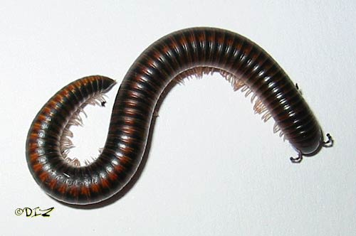
Millipedes

Slide 12
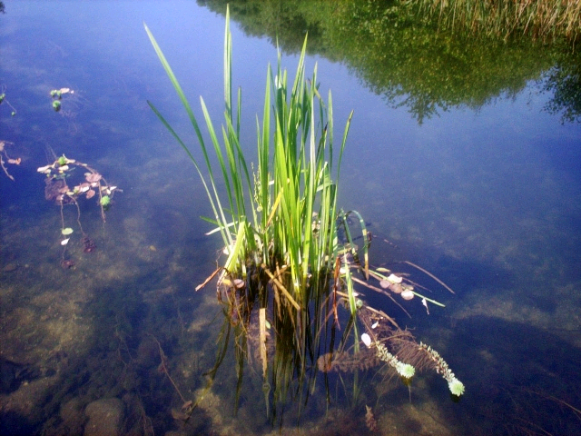
Flora
Plants
Soil
Water
Mud
Stones

Slide 13
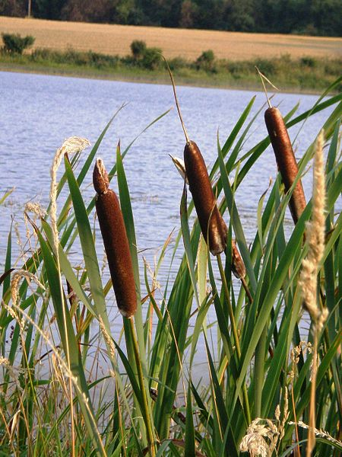
Moisture
Light
Temperature
Air

Slide 14
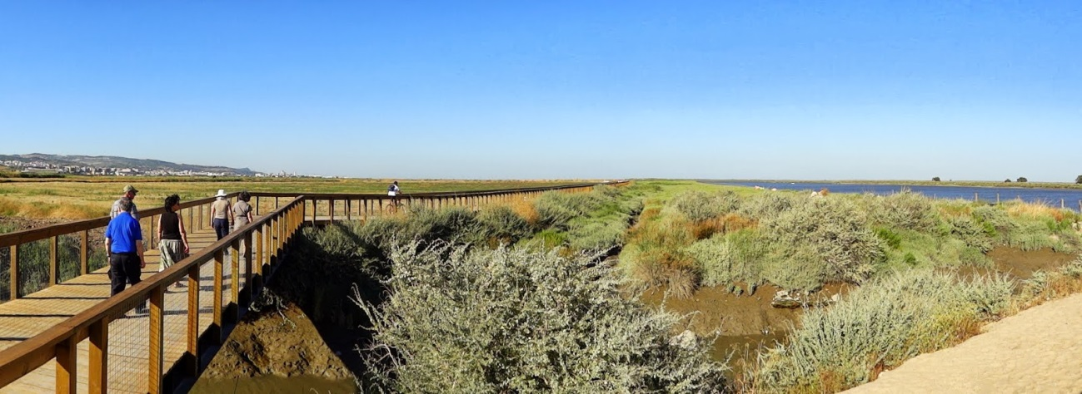
A landscape with great natural value and high pedagogical interest, characterized by extensive areas that provide the observation of fauna and flora.

Slide 15

Let’s write what we have learnt!

